Slide 1
Unit-3.1 Error Correction and Detection
Prepared By:
Prof. Vishal A. Polara
Assistant Professor
Information Technology Department
Birla Vishvakarma Mahavidyalaya Engineering College

Slide 2
Outline
Types of Errors
Block coding
Linear block codes
Cyclic codes
Checksum

Slide 3
1. Types of errors
There are two types of errors
Single bit errors : Only one bit in data unit has changed
multi bit errors: It is also known as burst error where more than two bit in data unit has changed
Here 0 changes to 1 and 1 changes to 0.
Single bit errors are normally seen least in serial data transmission.
Burst error is more likely to occur than a single bit error. It occurs due to noise because duration of noise is longer than the duration of 1 bit. So noise affect more numbers of data.

Slide 4
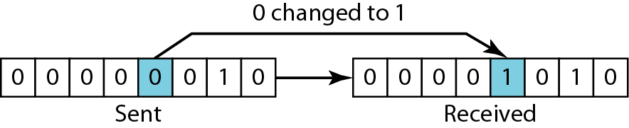
Figure Single-bit error

Slide 5
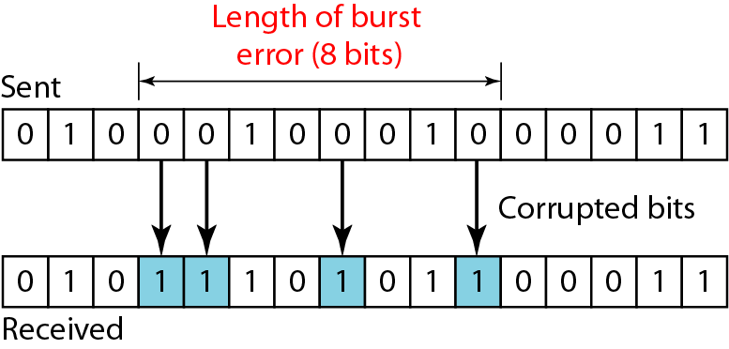
Figure Burst error of length 8

Slide 6
Error correction and detection using Redundancy
To detect or correct errors we need to send some extra bits with our data.
These redundant bits are added by the sender and removed by the receiver. It allows receiver to detect or correct corrupted bits.
Error detection means we have to change if bit changed or not.
While in case of error correction we need to know the exact number of bits that are corrupted and their location in the message.
If we need to correct one single error in an 8-bit data unit we need to consider eight possible error locations, if we need to correct two errors in a data unit of the same size we need to consider 28 possibilities.
Redundancy achieve using various coding schemes. The sender adds the redundant bits through a process that creates relationship between the redundant bits and the actual data bits.

Slide 7
Redundancy achieve using various coding schemes. The sender adds the redundant bits through a process that creates relationship between the redundant bits and the actual data bits.
The receiver checks the relationships between the two sets of bits to detect or correct the errors.
There are two coding schemes available:
Block coding
Convolution coding

Slide 8
Method of correction
There are two main methods of error correction.
Forward error correction
Retransmission
Forward error correction is the process in which the receiver tries to guess the message by using redundant bits. If the number of errors is small
Retransmission is a technique in which the receiver detects the occurrence of an error and asks the sender to resend the message.

Slide 9
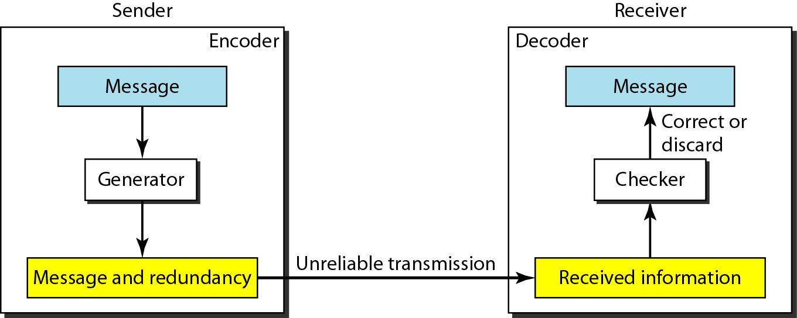
Figure The structure of encoder and decoder

Slide 10
In modulo-N arithmetic, we use only the integers in the range 0 to N −1, inclusive.

Slide 11
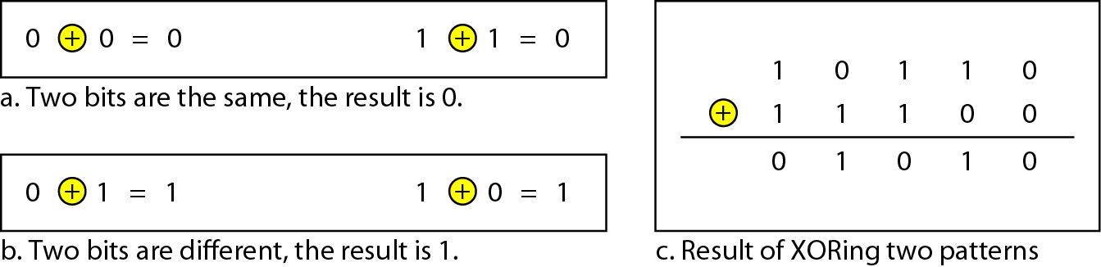
Figure XORing of two single bits or two words

Slide 12
2. Block Coding
In block coding, we divide our message into blocks, each of k bits, called datawords. We add r redundant bits to each block to make the length n = k + r. The resulting n-bit blocks are called codewords.
With k bits we can create a combination of 2^k data words and with n bits we can create a combination of 2^k codewords.
In block coding same data word is always encoded using same code words that mean 2^n – 2^k codewords are not used. It is known as invalid or illegal codewords.
Error Detection
Error Correction
Hamming Distance
Minimum Hamming Distance

Slide 13
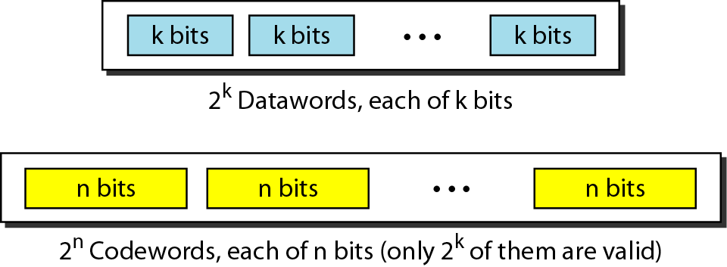
Figure Datawords and codewords in block coding

Slide 14
Example
The 4B/5B block coding discussed in previous unit is a good example of this type of coding. In this coding scheme, k = 4 and n = 5. As we saw, we have 2^{k} = 16 datawords and 2^{n} = 32 codewords. We saw that 16 out of 32 codewords are used for message transfer and the rest are either used for other purposes or unused.

Slide 15
Error Detection
In Block coding error detection is possible if following two condition met.
The receiver has a list of valid codewords
The original codeword has changed to an invalid one
The sender creates codewords out of datawords by using a generator that applies the rules and procedures of encoding.
Each codeword sent to the receiver may change during transmission.
If it is same than accepted else received codeword is not valid, it is discarded.
If it is corrupted but still matched with a valid codeword the errors remain undetected.

Slide 16
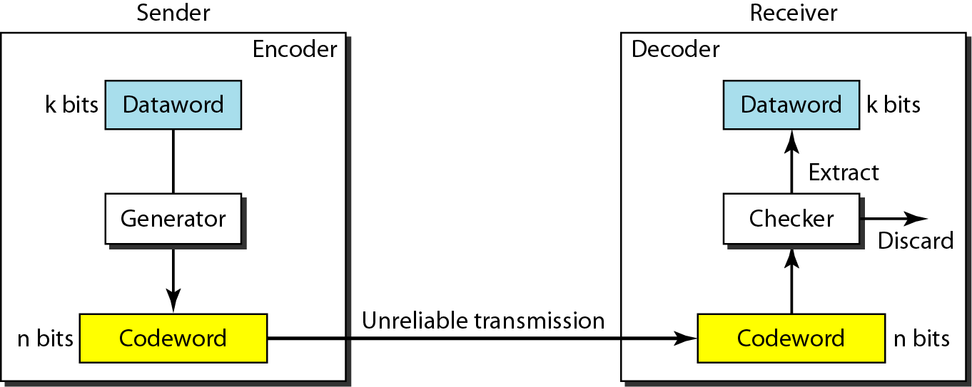
Figure Process of error detection in block coding

Slide 17
Example
Let us assume that k = 2 and n = 3. Table shows the list of datawords and codewords. Later, we will see how to derive a codeword from a dataword.
Assume the sender encodes the dataword 01 as 011 and
sends it to the receiver. Consider the following cases:
1. The receiver receives 011. It is a valid codeword. The receiver extracts the dataword 01 from it.

Slide 18
Example (continued)
2. The codeword is corrupted during transmission, and 111 is received. This is not a valid codeword and is discarded.
3. The codeword is corrupted during transmission, and 000 is received. This is a valid codeword. The receiver incorrectly extracts the dataword 00. Two corrupted bits have made the error undetectable.

Slide 19
Table A code for error detection

Slide 20
An error-detecting code can detect only the types of errors for which it is designed; other types of errors may remain undetected.

Slide 21
Error Correction
In error correction we need more redundant bits.

Slide 22
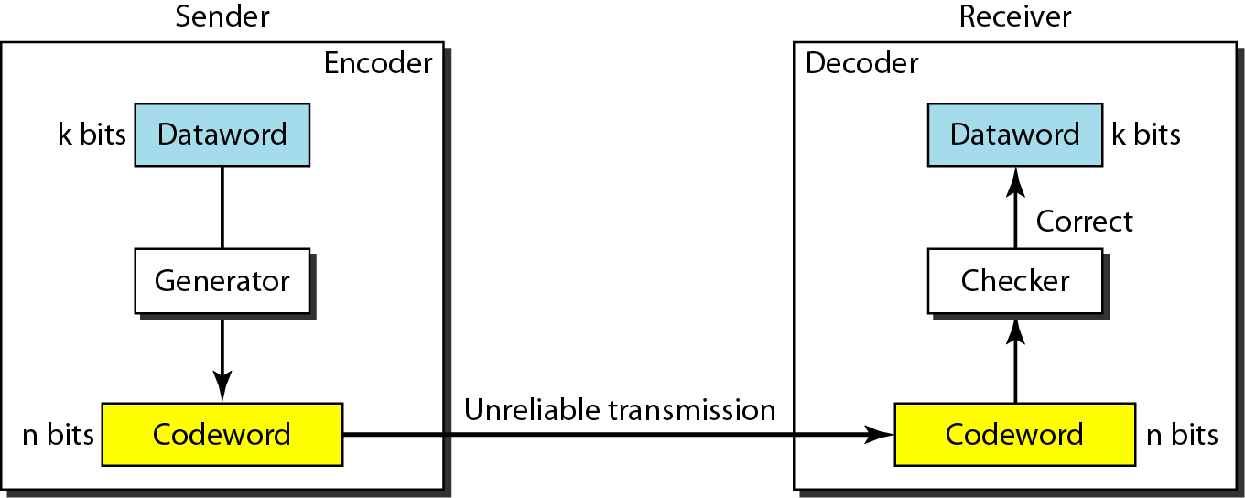
Figure Structure of encoder and decoder in error correction

Slide 23
Example
Let us add more redundant bits to previous example to see if the receiver can correct an error without knowing what was actually sent. We add 3 redundant bits to the 2-bit dataword to make 5-bit codewords. Table shows the datawords and codewords. Assume the dataword is 01. The sender creates the codeword 01011. The codeword is corrupted during transmission, and 01001 is received. First, the receiver finds that the received codeword is not in the table. This means an error has occurred. The receiver, assuming that there is only 1 bit corrupted, uses the following strategy to guess the correct dataword.

Slide 24
Example
1. Comparing the received codeword with the first codeword in the table (01001 versus 00000), the receiver decides that the first codeword is not the one that was sent because there are two different bits.
2. By the same reasoning, the original codeword cannot be the third or fourth one in the table.
3. The original codeword must be the second one in the table because this is the only one that differs from the received codeword by 1 bit. The receiver replaces 01001 with 01011 and consults the table to find the dataword 01.

Slide 25
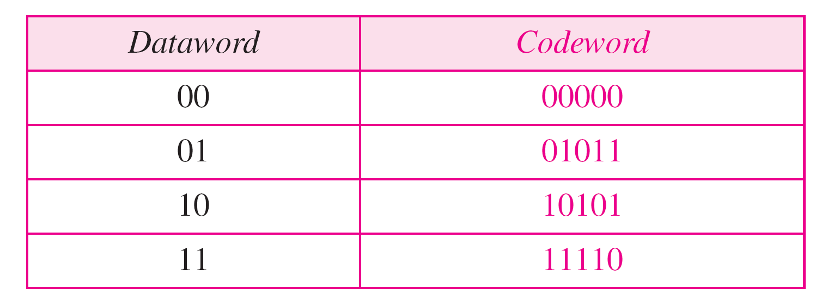
Table A code for error correction

Slide 26
Hamming Distance
The Hamming distance between two words is the number of differences between corresponding bits.
The hamming distance cab be found by applying the XOR operation on the two words and count the number of 1s in the result. It must be greater than zero.
Minimum hamming distance is the smallest hamming distance between all possible pairs.
It requires to define minimum hamming distance in coding scheme.
To decide this we find the hamming distances between all words and select the smallest one.
Any coding scheme required three parameters codeword size n, data word size k, and minimum hamming distance dmin.
If our code is to detect upto S errors the minimum hamming distance between the valid codes must be S+1 so that the received codeword does not match the valid codeword

Slide 27
Hamming Distance
The minimum hamming distance for error correction is dmin = 2t + 1.

Slide 28
Example
Let us find the Hamming distance between two pairs of words.
1. The Hamming distance d(000, 011) is 2 because
2. The Hamming distance d(10101, 11110) is 3 because

Slide 29
Example
Find the minimum Hamming distance of the coding scheme
Solution
We first find all Hamming distances.
The d_{min} in this case is 2.

Slide 30
Table A code for error detection

Slide 31
Table A code for error correction

Slide 32
Example
Find the minimum Hamming distance of the coding scheme
Solution
We first find all the Hamming distances.
The d_{min} in this case is 3.

Slide 33
Example
The minimum Hamming distance for our first code scheme is 2. This code guarantees detection of only a single error. For example, if the third codeword (101) is sent and one error occurs, the received codeword does not match any valid codeword. If two errors occur, however, the received codeword may match a valid codeword and the errors are not detected.

Slide 34
Example
A code scheme has a Hamming distance d_{min} = 4. What is the error detection and correction capability of this scheme?
Solution
This code guarantees the detection of up to three errors (s = 3), but it can correct up to one error. In other words, if this code is used for error correction, part of its capability is wasted. Error correction codes need to have an odd minimum distance (3, 5, 7, . . . ).

Slide 35
2. Linear Block codes
The use of nonlinear block codes for error detection and correction is not widespread because of their structure.
A linear block code is a code in which the exclusive OR of two valid codewords creates another valid codeword.
The minimum hamming distance is the number of 1s in the nonzero valid codeword with the smallest number of 1s.
Simple parity check code:
It is used to detect single bit error.
In this technique codeword is get replace by adding extra bit which is parity bit to make total number of 1s in the codeword even.
At receiver side addition is done over all 5 bits. It is called syndrome. If it is 0 when the number of 1s in the received codeword is even otherwise it is 1.

Slide 36
Table Simple parity-check code C(5, 4)

Slide 37
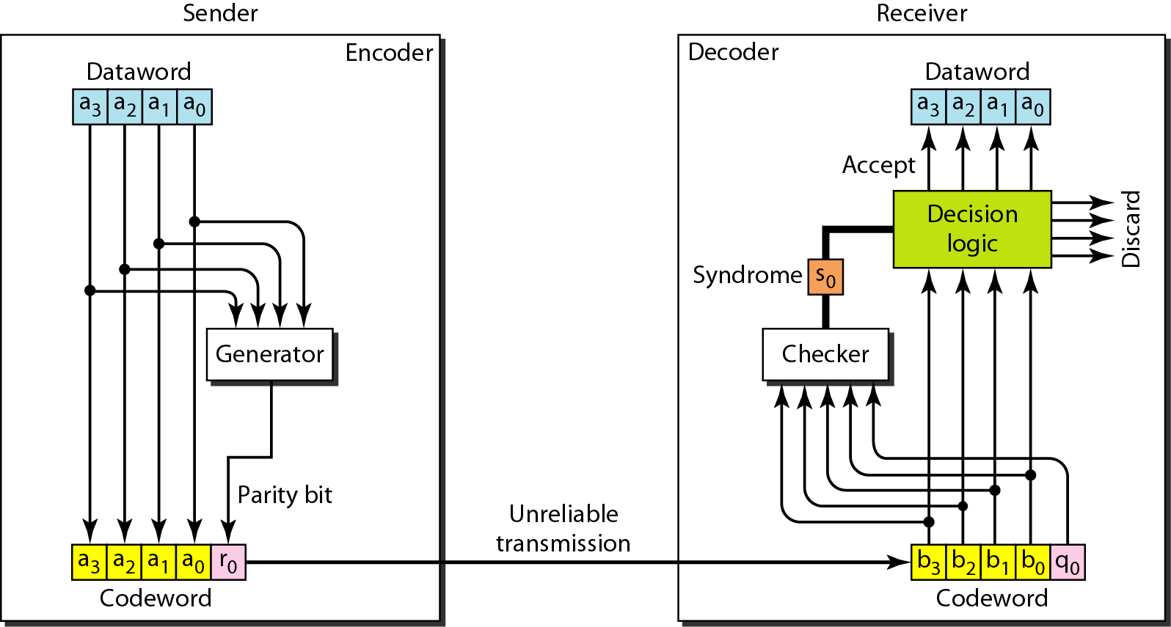
Figure Encoder and decoder for simple parity-check code

Slide 38
Example
Let us look at some transmission scenarios. Assume the sender sends the dataword 1011. The codeword created from this dataword is 10111, which is sent to the receiver. We examine five cases:
1. No error occurs; the received codeword is 10111. The syndrome is 0. The dataword 1011 is created.
2. One single-bit error changes a₁ . The received codeword is 10011. The syndrome is 1. No dataword is created.
3. One single-bit error changes r₀ . The received codeword is 10110. The syndrome is 1. No dataword is created.

Slide 39
Example
4. An error changes r₀ and a second error changes a₃ .The received codeword is 00110. The syndrome is 0. The dataword 0011 is created at the receiver. Note that
here the dataword is wrongly created due to the syndrome value.
5. Three bits—a₃, a₂, and a₁—are changed by errors. The received codeword is 01011. The syndrome is 1. The dataword is not created. This shows that the simple parity check, guaranteed to detect one single error, can also find any odd number of errors.

Slide 40
2. Linear Block codes
Hamming Codes:
It is used for error correction with dmin = 3 which means it can detect upto two errors or correct one single error.
It requires to chose m>=3. the value of n and k are then calculated from m as n=2^{m}-1 and k=n-m. the number of check bits r=m.
For example if m=3 then n=7 and k=4.
A copy of a 4-bit dataword is fed into the generator that creates three parity checks r0.r1,r2
r0= a2 +a1+a0 modulo-2
r1= a3+a2+a1 modulo-2
r2= a1+a0+a3 modulo-2
The checker in the decoder creates a 3-bit syndrome(s2s1s0) in which each bit is the parity check for 4 out of the 7 bits in the received codeword.

Slide 41
Hamming code
The checker in the decoder creates a 3-bit syndrome(s2s1s0) in which each bit is the parity check for 4 out of the 7 bits in the received codeword.
s0= b2+b1+b0+q0 modulo-2
s1=b3+b2+ b1+q1 modulo-2
s2=b1+b0+b3+q2 modulo-2
The equation used by checker is same as used by generator with the parity check bits added to the right hand side of the equation.
The 3 bit syndrome creates eight different bit patterns than can represent eight different conditions.
The condition define a lack of error or an error in 1 of the 7 bits of the received codeword.

Slide 42
Hamming code
Performance:
It can only correct a single error or detect a double error. It can also detect burst error.
The key is to split a burst error between several codewords one error for each codeword.

Slide 43
Table Hamming code C(7, 4)

Slide 44
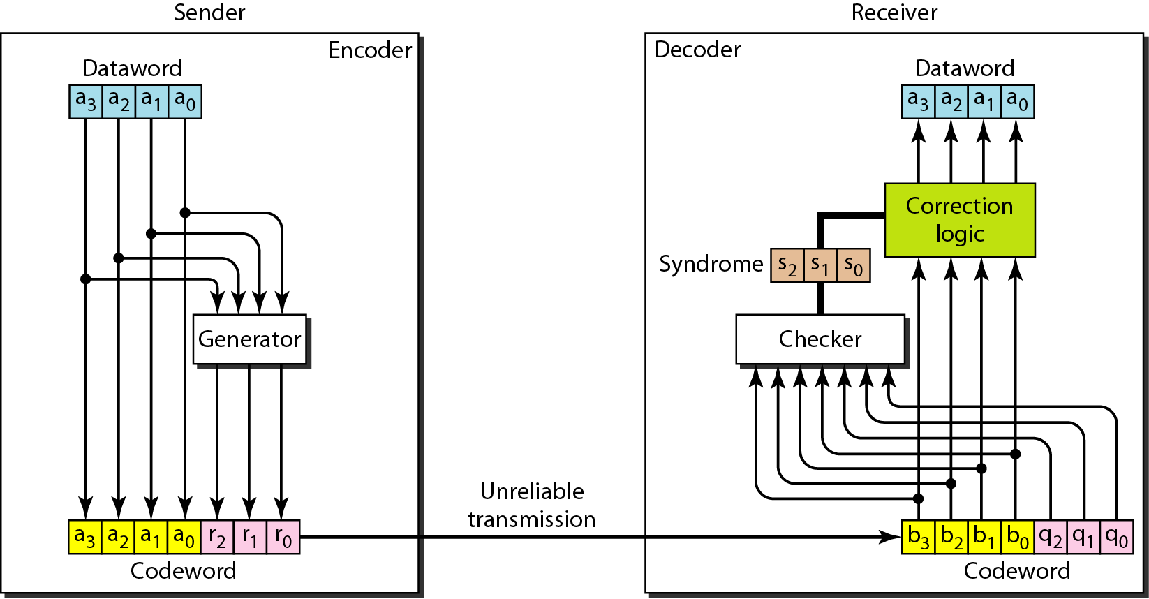
Figure The structure of the encoder and decoder for a Hamming code

Slide 45
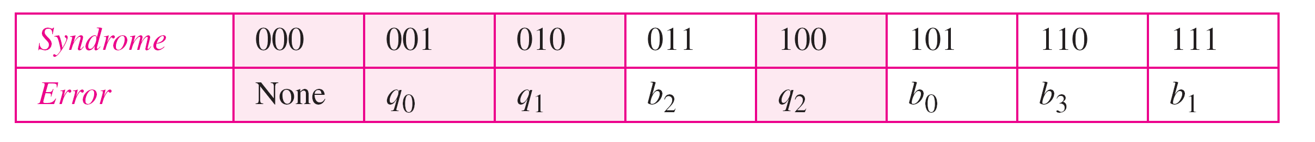
Table Logical decision made by the correction logic analyzer

Slide 46
Example
Let us trace the path of three datawords from the sender to the destination:
1. The dataword 0100 becomes the codeword 0100011. The codeword 0100011 is received. The syndrome is 000, the final dataword is 0100.
2. The dataword 0111 becomes the codeword 0111001. The syndrome is 011. After flipping b₂ (changing the 1 to 0), the final dataword is 0111.
3. The dataword 1101 becomes the codeword 1101000. The syndrome is 101. After flipping b₀, we get 0000, the wrong dataword. This shows that our code cannot correct two errors.

Slide 47
Example
We need a dataword of at least 7 bits. Calculate values of k and n that satisfy this requirement.
Solution
We need to make k = n − m greater than or equal to 7, or 2m − 1 − m ≥ 7.
1. If we set m = 3, the result is n = 23 − 1 and k = 7 − 3, or 4, which is not acceptable.
2. If we set m = 4, then n = 24 − 1 = 15 and k = 15 − 4 =11, which satisfies the condition. So the code is
C(15, 11)

Slide 48
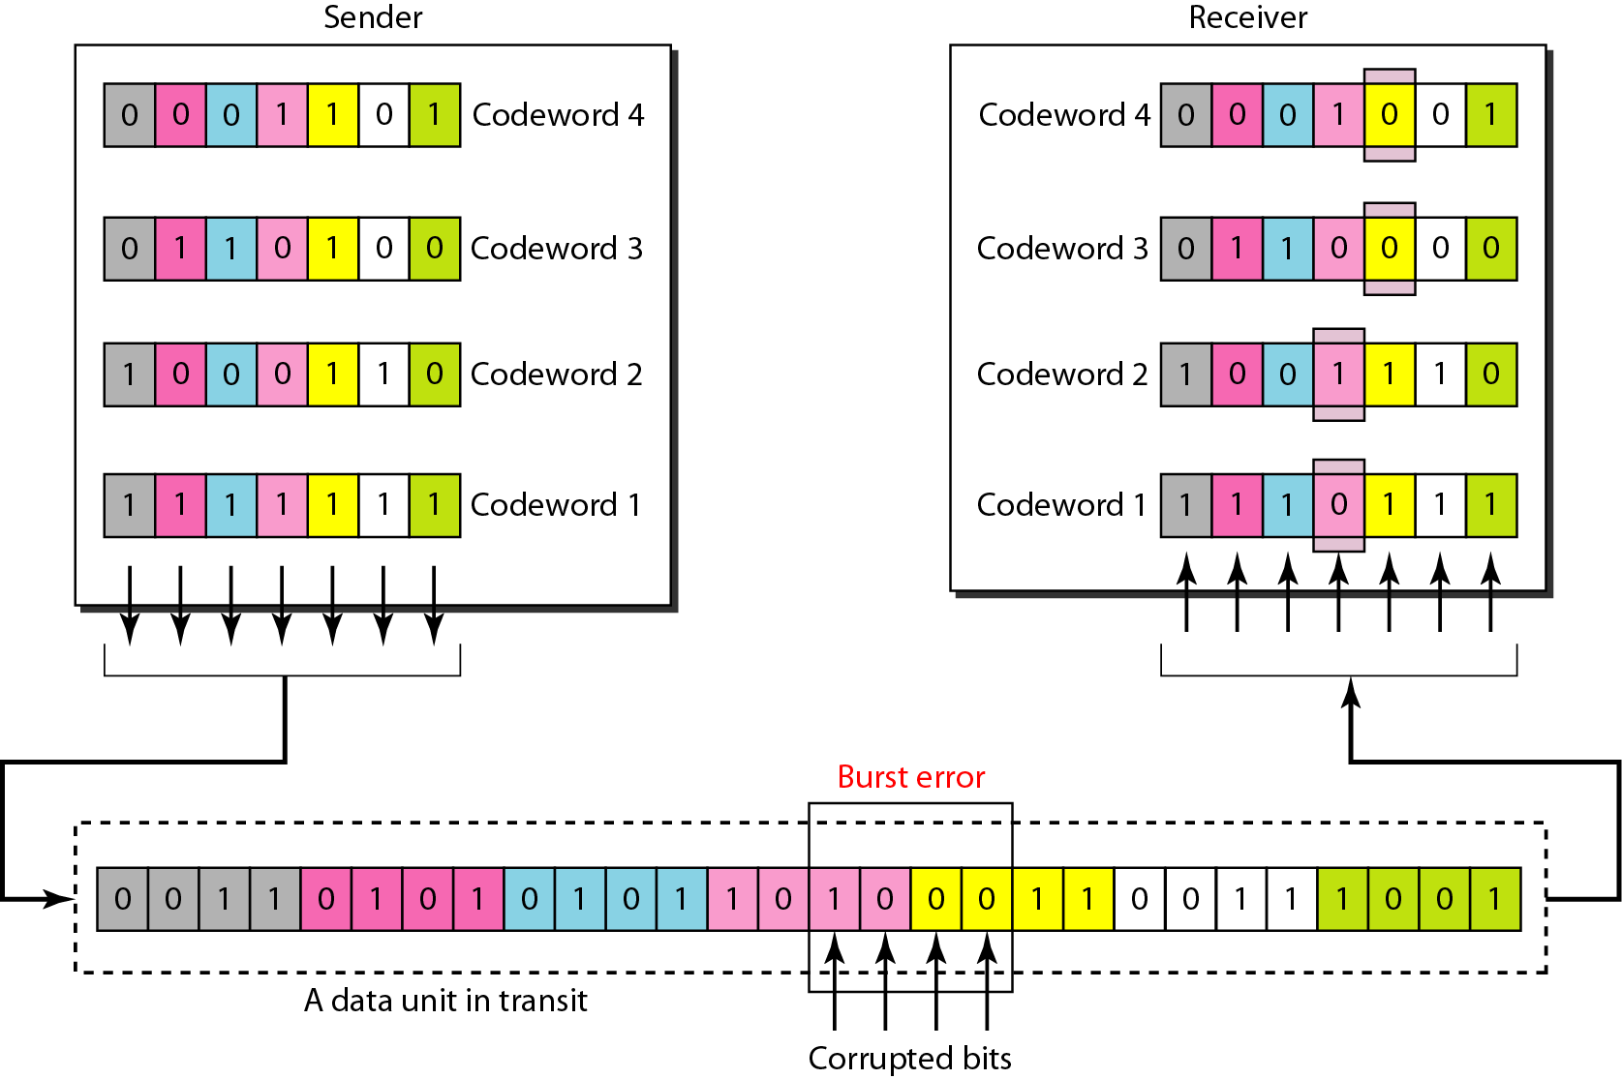
Figure Burst error correction using Hamming code

Slide 49
3. Cyclic code
Cyclic codes are special linear block codes with one extra property. In a cyclic code, if a codeword is cyclically shifted (rotated), the result is another codeword.
It is used to correct error. It is used in LAN and WAN.
In the encoder the dataword has k bits, the code word has n bits.
The size of the dataword is augmented by adding n-k 0s to the right hand side of the word.
The n-bit result is fed into the generator. The generator uses a divisor of size=n-k+1(4 bits), which is predefined and agreed upon.
The generator divides the augmented dataword by the divisor( modulo-2 division).
The remainder(r2r1r0) is appended to the dataword to create the codeword.

Slide 50
3. Cyclic code
Decoder receive the codeword. Checker generate the remainder which is called syndrome of n-k bits, which is fed to the decision logic analyzer.
The analyzer has a simple function. If the syndrome bits are all 0s, the 4 leftmost bits of the code word are accepted as the data word otherwise the 4 bits are discarded.

Slide 51
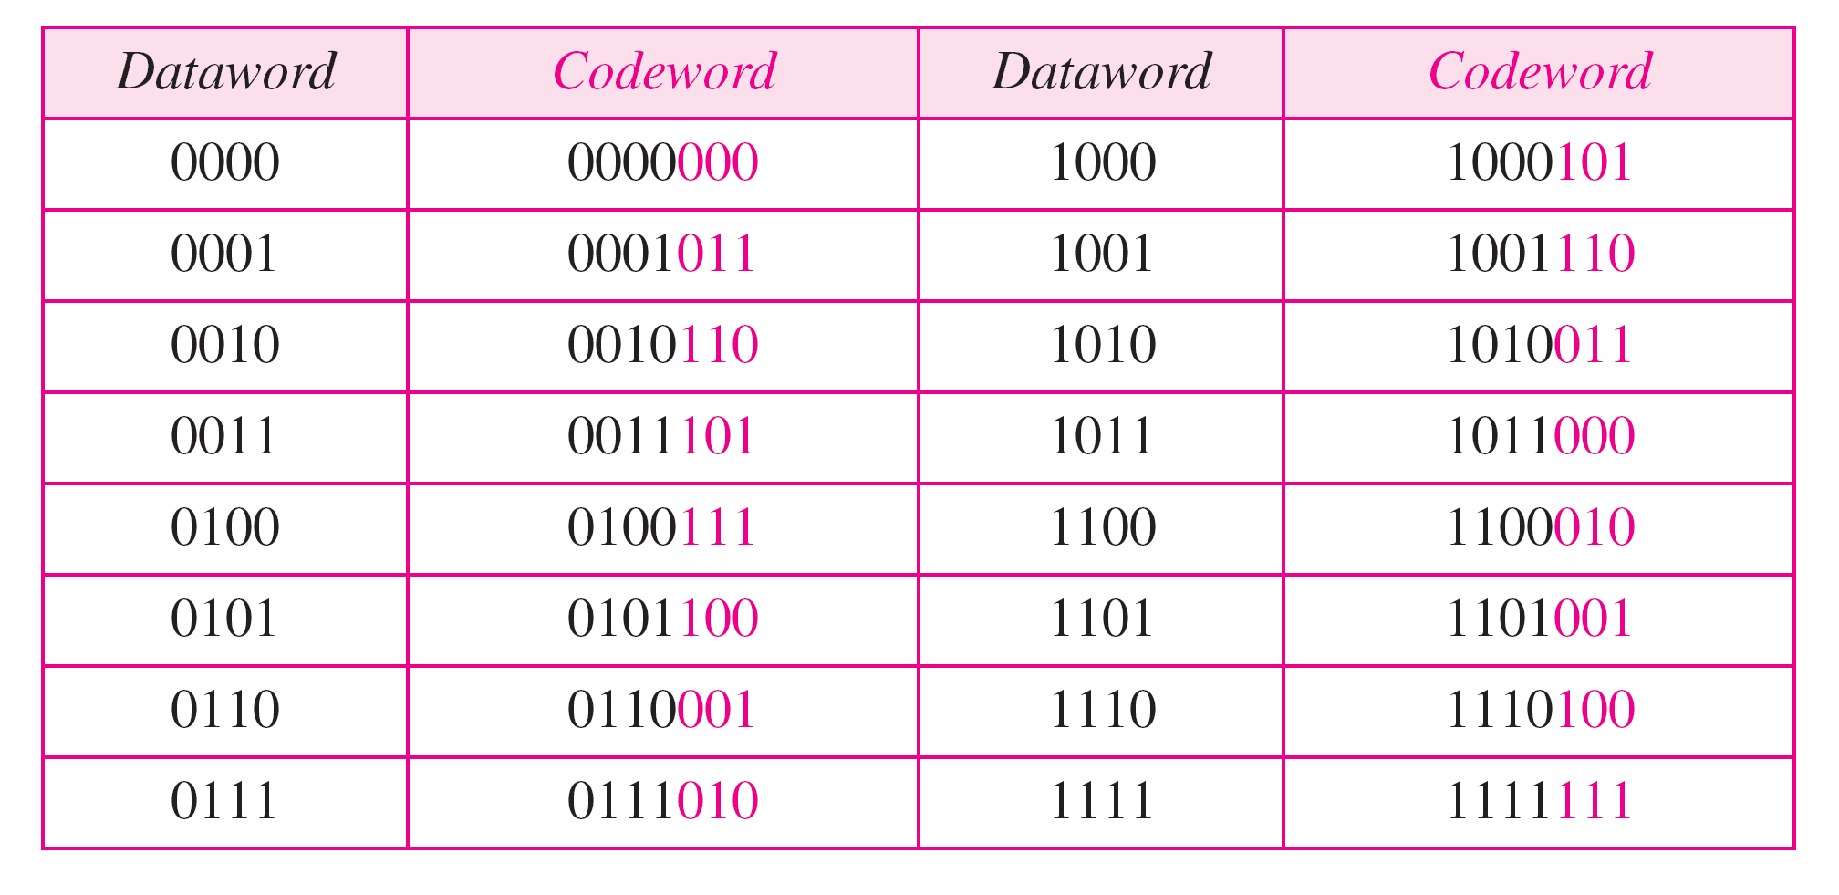
Table A CRC code with C(7, 4)

Slide 52
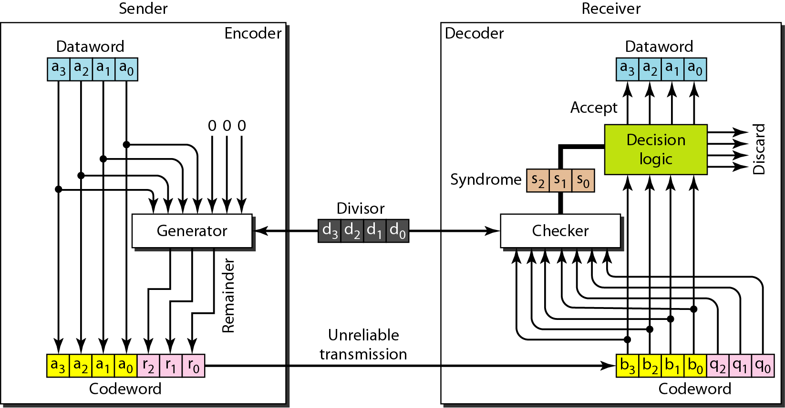
Figure CRC encoder and decoder

Slide 53
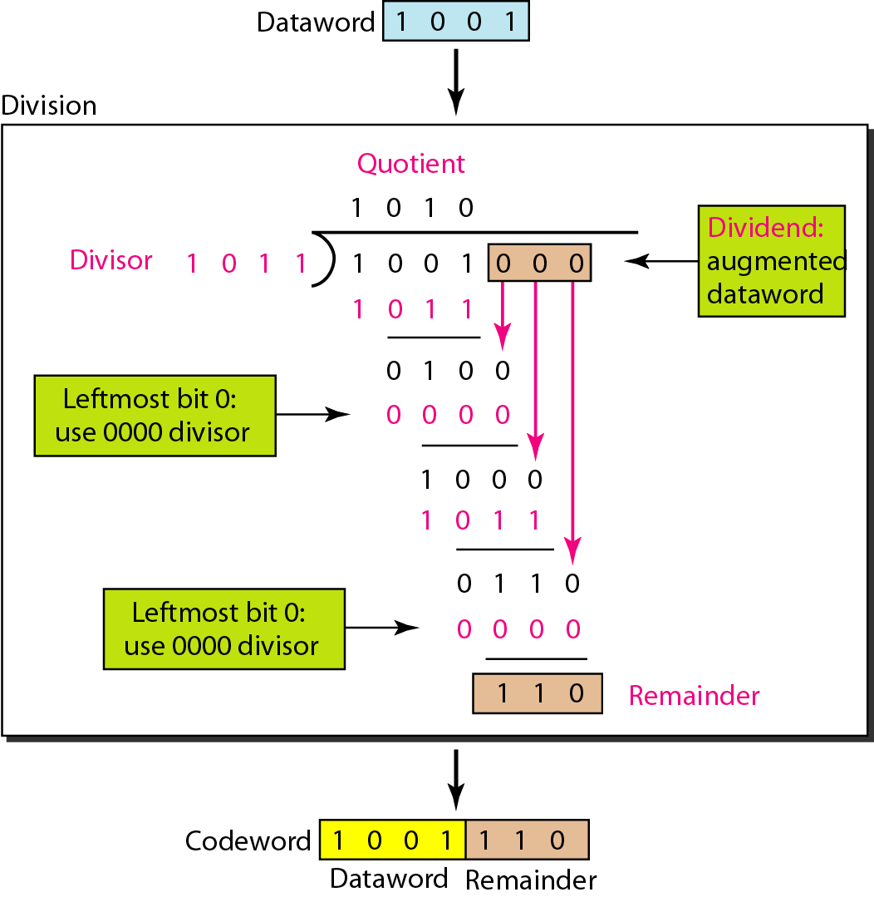
Figure Division in CRC encoder

Slide 54
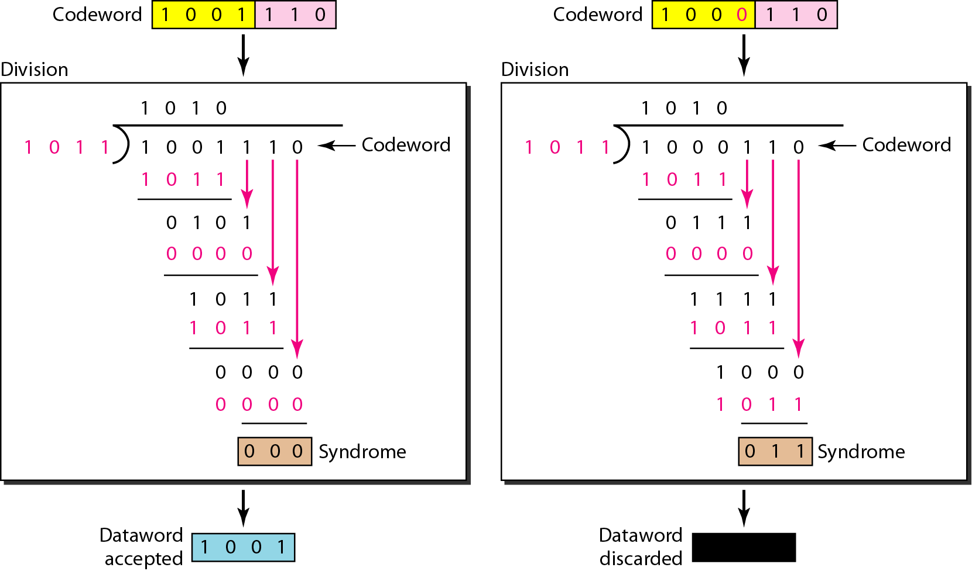
Figure Division in the CRC decoder for two cases

Slide 55
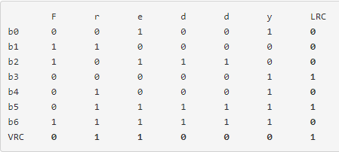
It is normally used for serial communication. In case of VRC odd parity bit scheme is used while for LRC even parity scheme is used.

Slide 56
3. Cyclic code in polynomial form
A pattern of 0s and 1s can be represented as a polynomial with coefficients of 0 and 1.
The power of each term shows the position of the bit, the coefficient shows the value of the bit.
The degree of the polynomial is 1 less than the number of bits in the pattern.
In example to find the augmented dataword we have left shifted the dataword 3 bits by multiplying by x3.

Slide 57
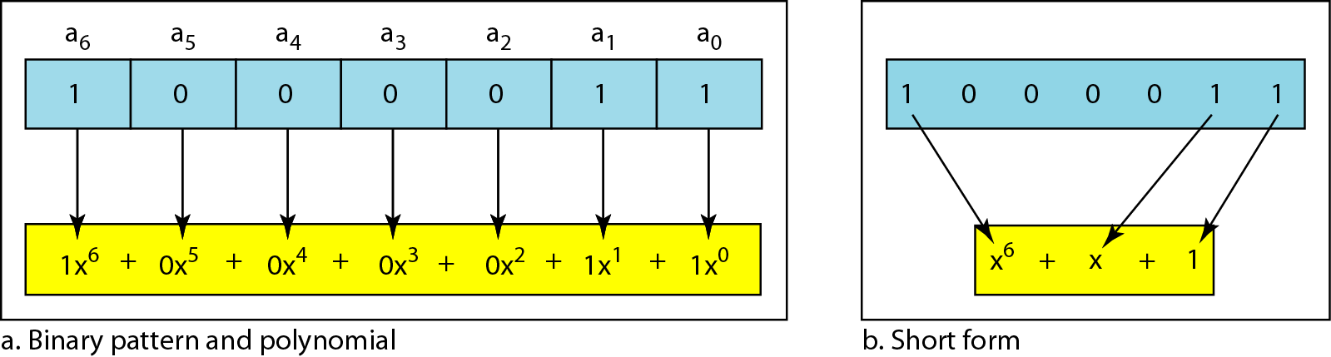
Figure polynomial to represent a binary word

Slide 58
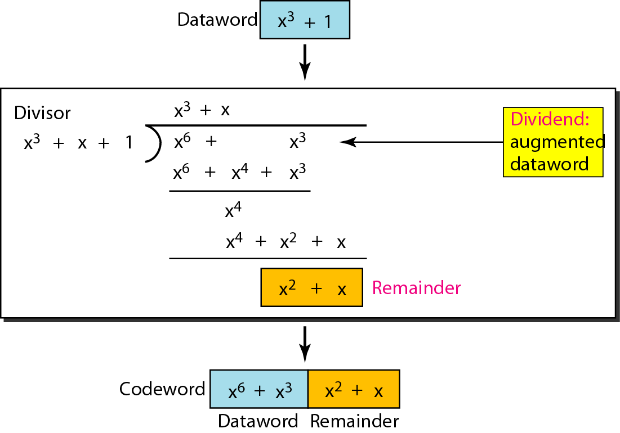
Figure CRC division using polynomials

Slide 59
Table Standard polynomials

Slide 60
4. Check sum
In checksum receiver send addition of all number with actual number
Here addition is send as negative value.
At receiver side again addition of actual value is done if some is 0 that means data are correct else there is an error in data.
One’s complement:
In this technique the number has more than n bits, the extra leftmost bits need to be added to the n rightmost bits(wrapping).

Slide 61
Example
Suppose our data is a list of five 4-bit numbers that we want to send to a destination. In addition to sending these numbers, we send the sum of the numbers. For example, if the set of numbers is (7, 11, 12, 0, 6), we send (7, 11, 12, 0, 6, 36), where 36 is the sum of the original numbers. The receiver adds the five numbers and compares the result with the sum. If the two are the same, the receiver assumes no error, accepts the five numbers, and discards the sum. Otherwise, there is an error somewhere and the data are not accepted.

Slide 62
Example
We can make the job of the receiver easier if we send the negative (complement) of the sum, called the checksum. In this case, we send (7, 11, 12, 0, 6, −36). The receiver can add all the numbers received (including the checksum). If the result is 0, it assumes no error; otherwise, there is an error.

Slide 63
Example
How can we represent the number 21 in one’s complement arithmetic using only four bits?
Solution
The number 21 in binary is 10101 (it needs five bits). We can wrap the leftmost bit and add it to the four rightmost bits. We have (0101 + 1) = 0110 or 6.

Slide 64
Example
How can we represent the number −6 in one’s complement arithmetic using only four bits?
Solution
In one’s complement arithmetic, the negative or complement of a number is found by inverting all bits. Positive 6 is 0110; negative 6 is 1001. If we consider only unsigned numbers, this is 9. In other words, the complement of 6 is 9. Another way to find the complement of a number in one’s complement arithmetic is to subtract the number from 2^{n} − 1 (16 − 1 in this case).

Slide 65
Example
Let us redo previous exercise using one’s complement arithmetic. Figure shows the process at the sender and at the receiver. The sender initializes the checksum to 0 and adds all data items and the checksum (the checksum is considered as one data item and is shown in color). The result is 36. However, 36 cannot be expressed in 4 bits. The extra two bits are wrapped and added with the sum to create the wrapped sum value 6. In the figure, we have shown the details in binary. The sum is then complemented, resulting in the checksum value 9 (15 − 6 = 9). The sender now sends six data items to the receiver including the checksum 9.

Slide 66
Example
The receiver follows the same procedure as the sender. It adds all data items (including the checksum); the result is 45. The sum is wrapped and becomes 15. The wrapped sum is complemented and becomes 0. Since the value of the checksum is 0, this means that the data is not corrupted. The receiver drops the checksum and keeps the other data items. If the checksum is not zero, the entire packet is dropped.

Slide 67
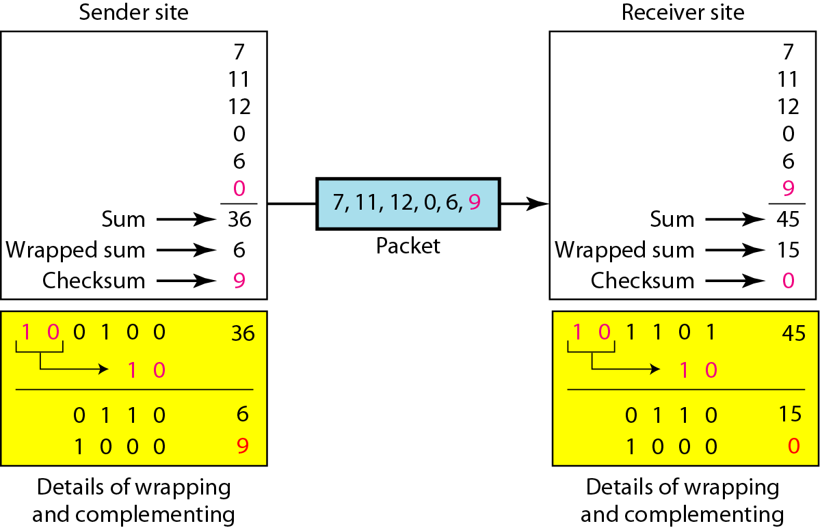
Figure

Slide 68
5. Flow Control
Flow control refers to a set of procedures used to restrict the amount of data that the sender can send before waiting for acknowledgment.
Error control in the data link layer is based on automatic repeat request, which is the retransmission of data.
Data link layer is responsible for creating frame which contain address of sender and receiver respectively.
Two types of framing is possible:
Fixed size framing: no need to define boundaries
Variable size framing: it requires to define beginning and end of frame.
Two way we can define boundary using character oriented protocols and bit oriented protocols.

Slide 69
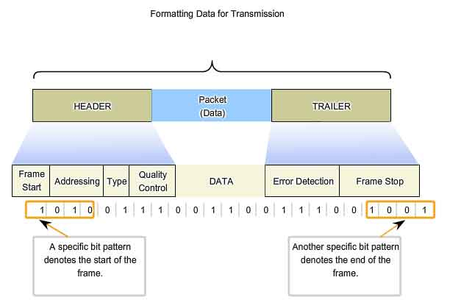

Slide 70
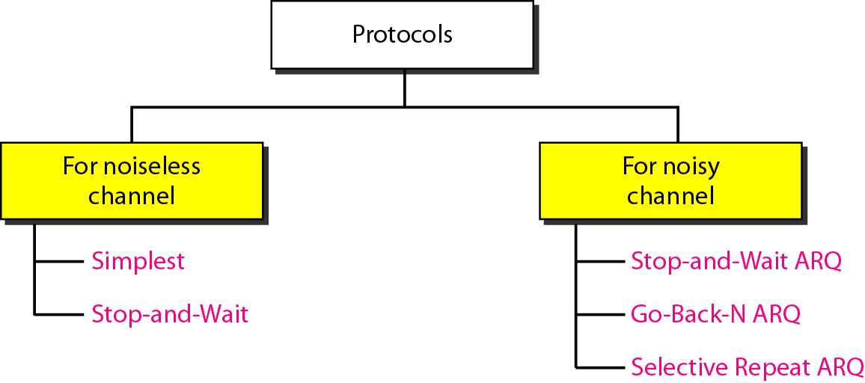
Figure Taxonomy of protocols

Slide 71
6. Noiseless Channel
It can support two protocols.
Simplest Protocol:
It is unidirectional protocol in which data frames are traveling in only one direction from sender to receiver.
There is no need for flow control in this scheme.
In this protocol sender side cannot send a frame until its network layer has a data packet to send.
The receiver site cannot deliver a data packet to its network layer until a frame arrives.
If the protocol is implemented as procedure we need to introduce the idea of events in the protocol.

Slide 72
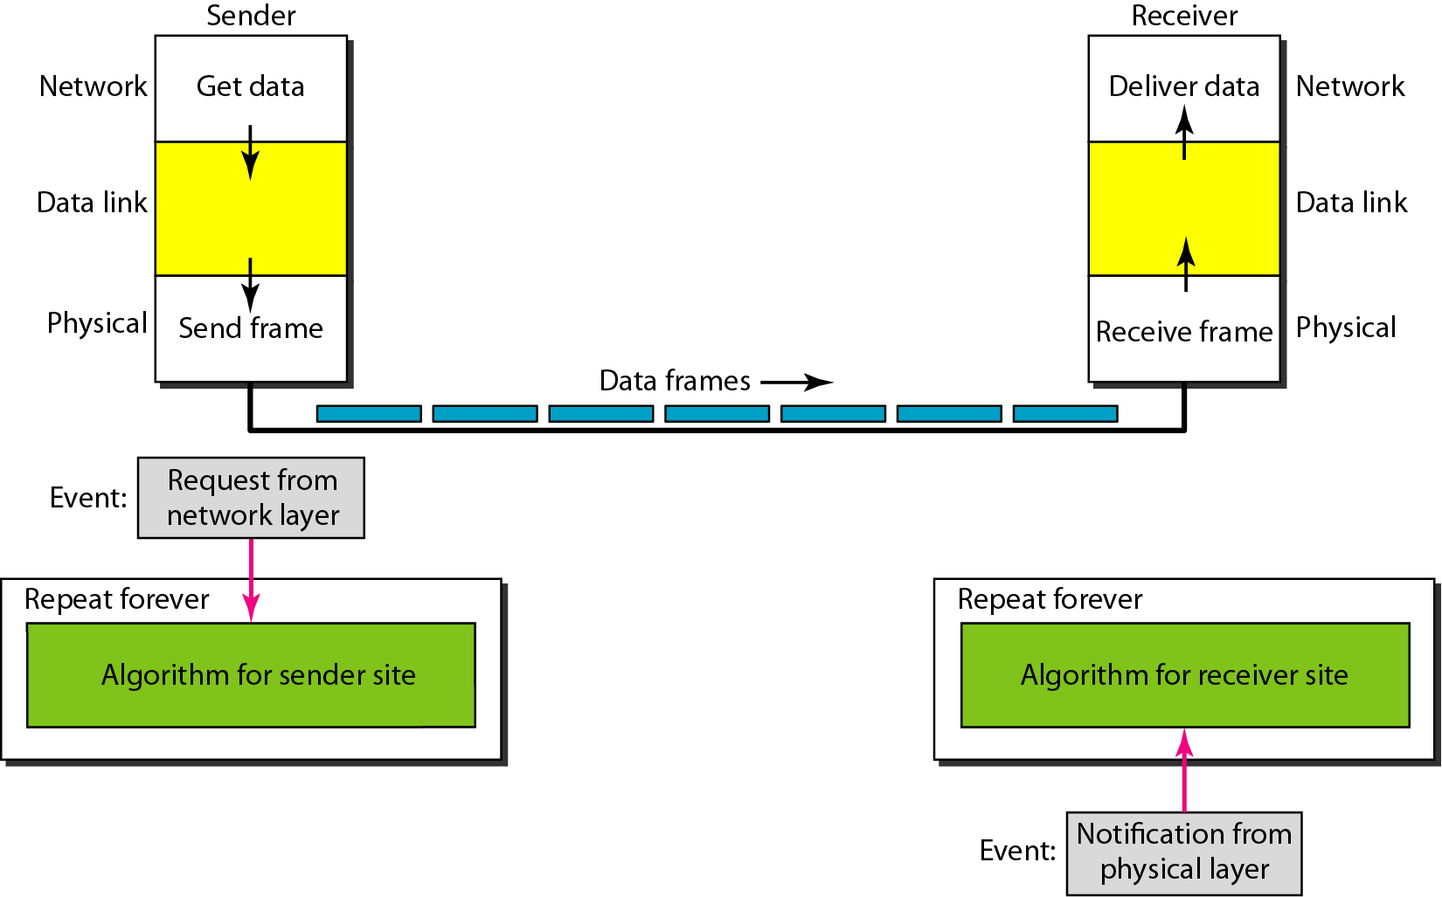
Figure The design of the simplest protocol with no flow or error control

Slide 73
Algorithm Sender-site algorithm for the simplest protocol

Slide 74
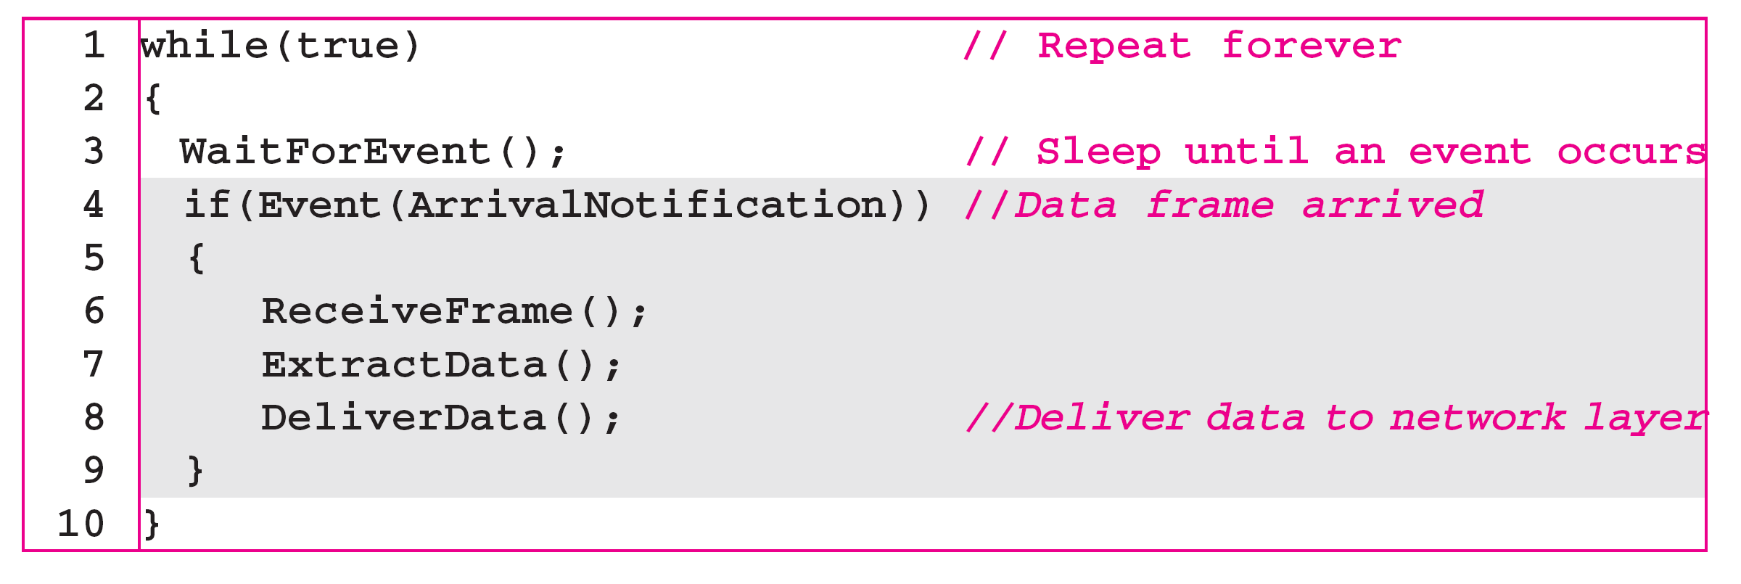
Algorithm Receiver-site algorithm for the simplest protocol

Slide 75
6. Noiseless Channel
Stop and wait Protocol:
It is used to overcome loss of frame when receiver is not capable to handle to much frame so frame get lost.
In this protocol sender sends one frame, stops until it receives confirmation from the receiver and then sends the next frame.
It also has unidirectional communication for data frames but auxiliary ACK frames from the other direction.
In this protocol flow control is added.

Slide 76
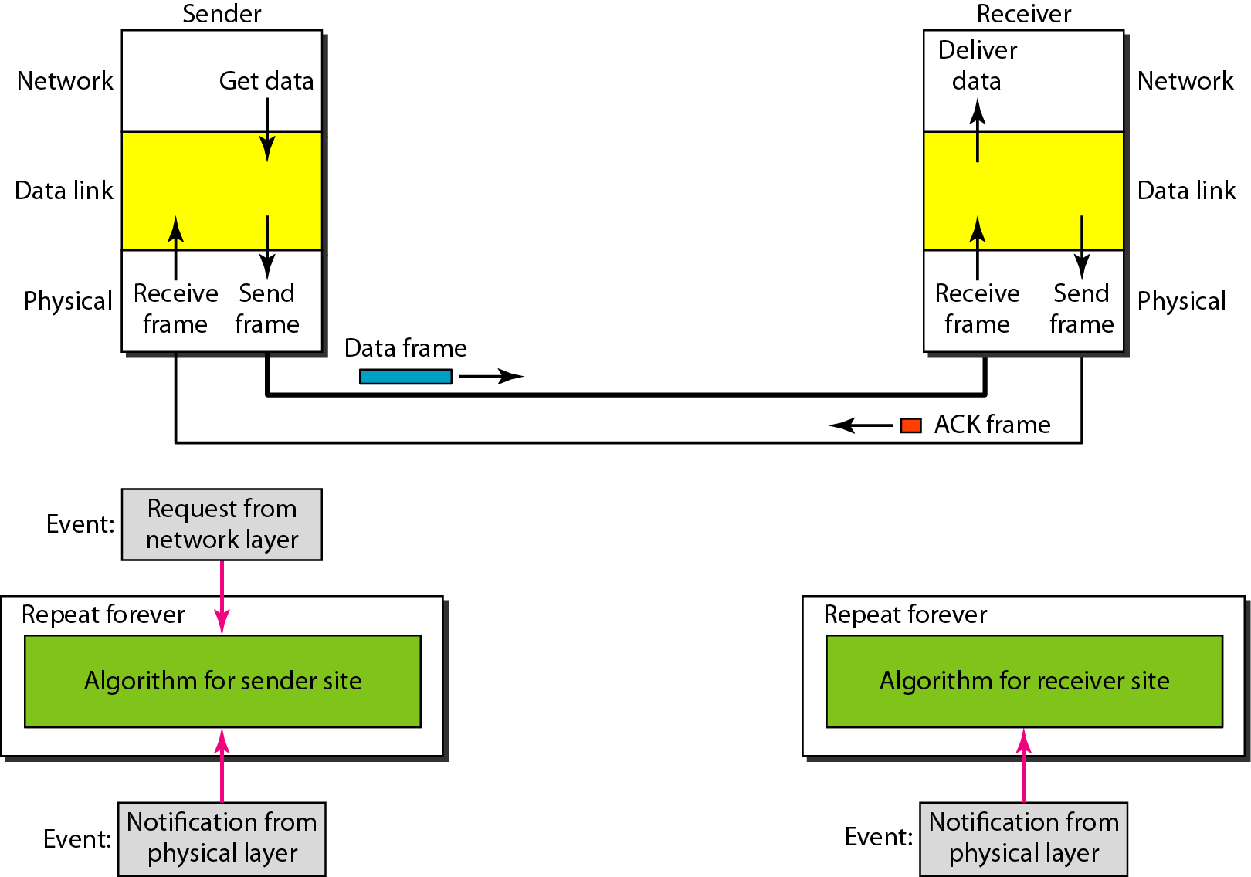
Figure Design of Stop-and-Wait Protocol

Slide 77
Algorithm Sender-site algorithm for Stop-and-Wait Protocol

Slide 78
Algorithm Receiver-site algorithm for Stop-and-Wait Protocol

Slide 79
7. Noisy Channel
It has three protocol
Stop-and-Wait Automatic Repeat Request
In this protocol flow control and error control is added.
To detect and correct corrupted frames redundancy is added.
In this protocol sender sends the frame and waits for the acknowledgement if he will not receive and ACK timer is set for particular frame so sender assumes that frame is discarded and he will resend it if ACK is not received.
Sequence number is assigned to each frame.
The sequence numbers start from 0 go to 2^{m}-1 and then are repeated.
Receiver send an acknowledgement based on next frame. If 0 is arrive safe it send 1 means he require next frame.

Slide 80
Stop-and-Wait ARQ Protocol
OR One-bit Sliding Window Protocol
Error correction in Stop-and-Wait ARQ is done by keeping a copy of the sent frame and retransmitting of the frame when the timer expires.
In Stop-and-Wait ARQ, we use sequence numbers to number the frames.
The sequence numbers are based on modulo-2 arithmetic (0,1,0,1,…).
In Stop-and-Wait ARQ, the acknowledgment number always announces in modulo-2 arithmetic the sequence number of the next frame expected.

Slide 81
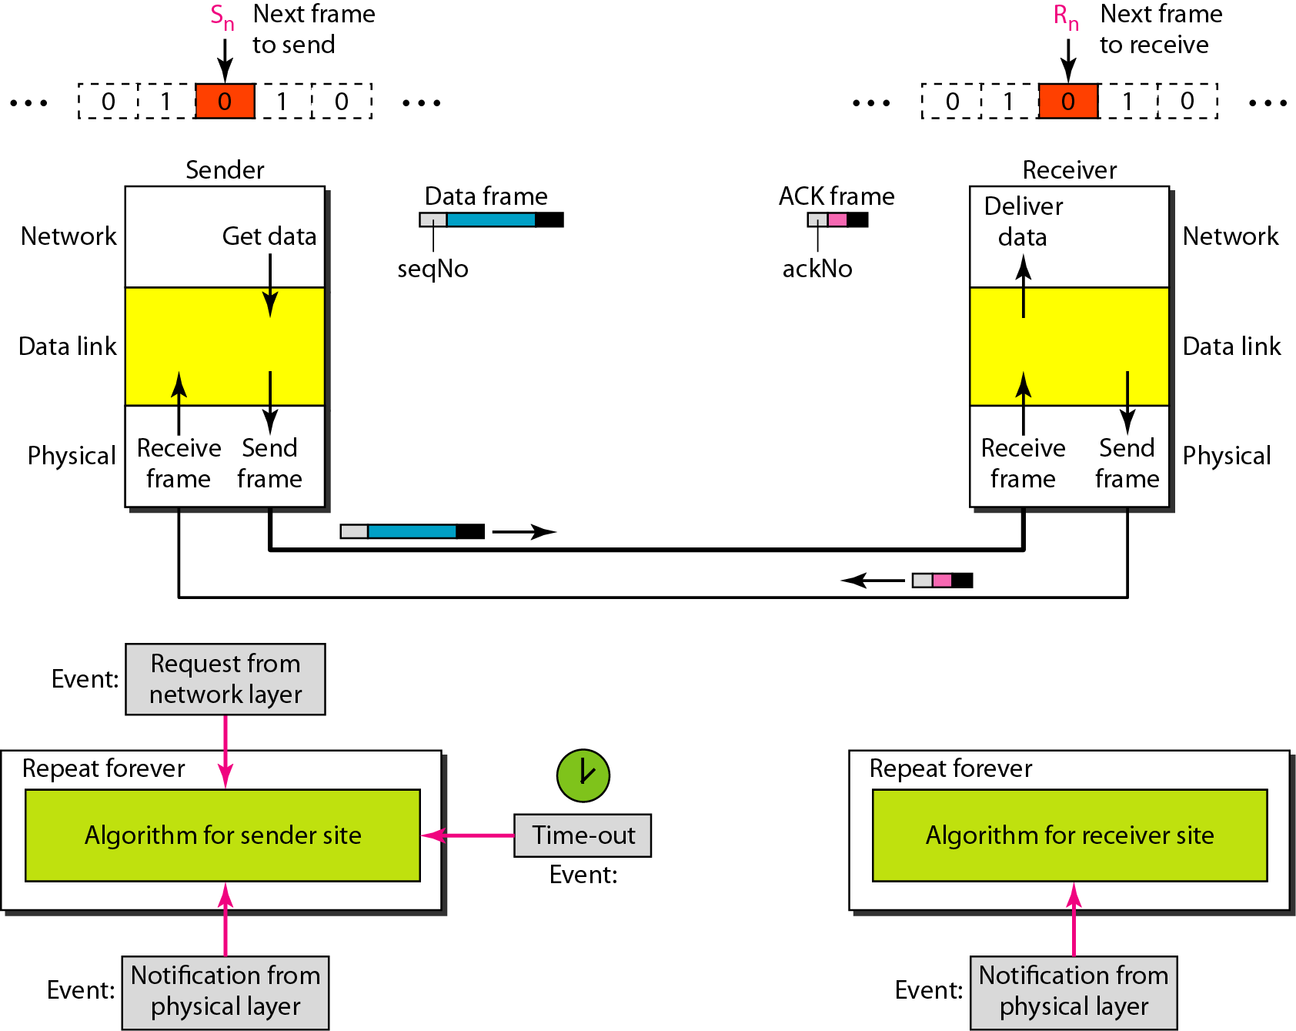
Figure Design of the Stop-and-Wait ARQ Protocol

Slide 82
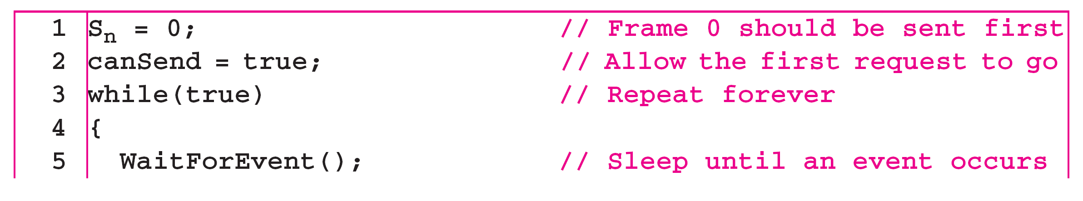
Algorithm Sender-site algorithm for Stop-and-Wait ARQ
(continued)

Slide 83
Algorithm Sender-site algorithm for Stop-and-Wait ARQ
(continued)

Slide 84
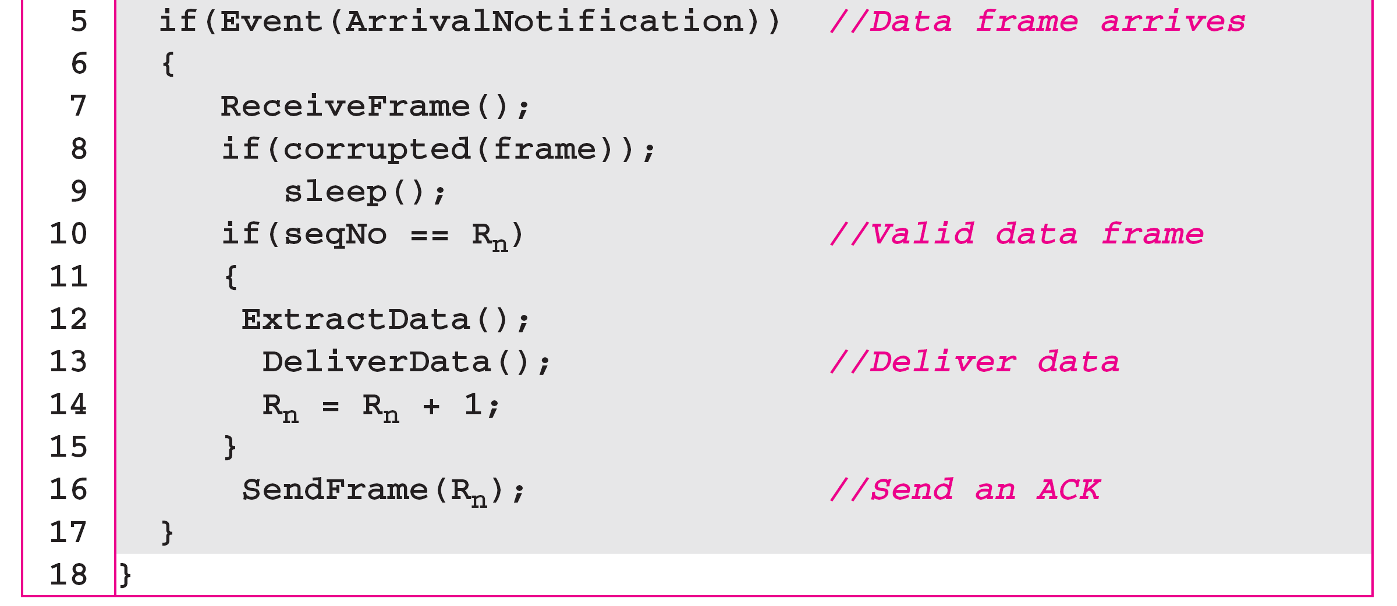
Algorithm Receiver-site algorithm for Stop-and-Wait ARQ Protocol

Slide 85
Example
Figure shows an example of Stop-and-Wait ARQ. Frame 0 is sent and acknowledged. Frame 1 is lost and resent after the time-out. The resent frame 1 is acknowledged and the timer stops. Frame 0 is sent and acknowledged, but the acknowledgment is lost. The sender has no idea if the frame or the acknowledgment is lost, so after the time-out, it resends frame 0, which is acknowledged.

Slide 86
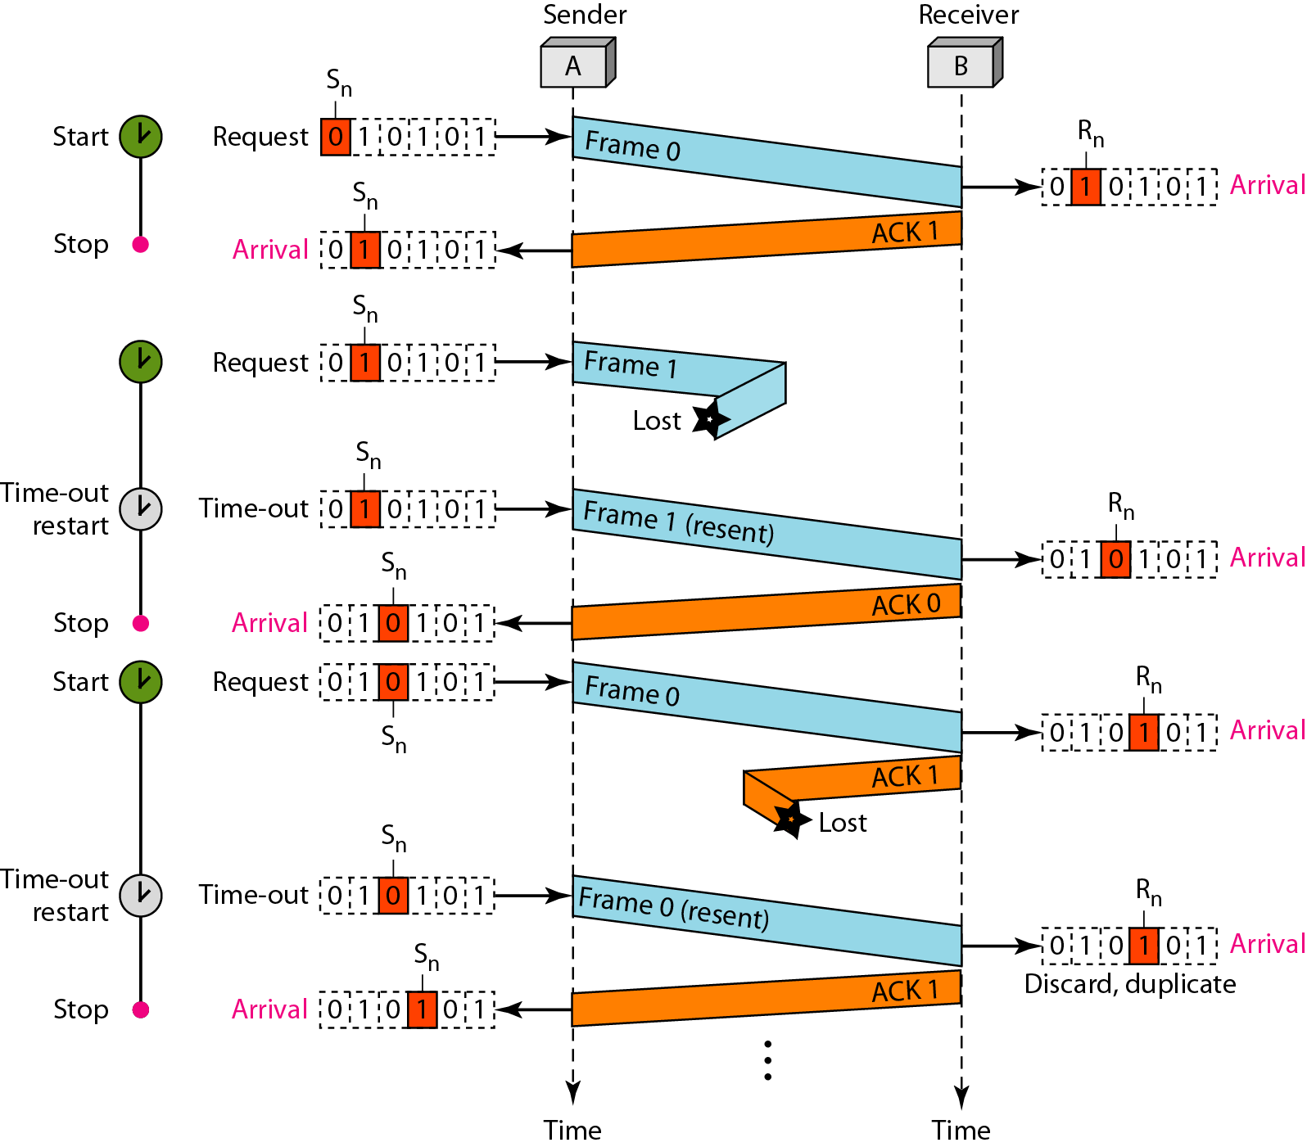
Figure Flow diagram

Slide 87
Example
Assume that, in a Stop-and-Wait ARQ system, the bandwidth of the line is 1 Mbps, and 1 bit takes 20 ms to make a round trip. What is the bandwidth-delay product? If the system data frames are 1000 bits in length, what is the utilization percentage of the link?
Solution
The bandwidth-delay product is

Slide 88
Example (continued)
The system can send 20,000 bits during the time it takes for the data to go from the sender to the receiver and then back again. However, the system sends only 1000 bits. We can say that the link utilization is only 1000/20,000, or 5 percent. For this reason, for a link with a high bandwidth or long delay, the use of Stop-and-Wait ARQ wastes the capacity of the link.

Slide 89
Example
What is the utilization percentage of the link in Example 11.4 if we have a protocol that can send up to 15 frames before stopping and worrying about the acknowledgments?
Solution
The bandwidth-delay product is still 20,000 bits. The system can send up to 15 frames or 15,000 bits during a round trip. This means the utilization is 15,000/20,000, or 75 percent. Of course, if there are damaged frames, the utilization percentage is much less because frames have to be resent.

Slide 90
Go-Back-N Protocol
In the Go-Back-N Protocol, the sequence numbers are modulo 2^{m}, where m is the size of the sequence number field in bits.
The send window is an abstract concept defining an imaginary box of size 2^{m} − 1 with three variables: Sf, Sn, and S_{size}.
The send window can slide one or more slots when a valid acknowledgment arrives.
The receive window is an abstract concept defining an imaginary box of size 1 with one single variable Rn. The window slides when a correct frame has arrived; sliding occurs one slot at a time.

Slide 91
Sliding window is theoretical protocol. It can be implemented using GBN (Go back N)and SR (selective repeat).
In GBN N>1 is always greater than 1 else it is stop and wait.
Receiver window size is always 1. because it will wait for one packet only.
It will accept packet in order only packet out of order will be discarded.
1. If packet lost in Go back N in that case all packet from last to unacknowledged will re transmitted if the time period expires.
2. acknowledgement lost : it normally send acknowledgment for many packet at a time ( It works on acknowledgment timer once timer expire all packet received within ack time for that packet ack will send).
Time out timer of data should be larger than ack timer.

Slide 92
There is a relationship between sequence number and window size is important.
Due to lost of acknowledgment there is a chance of receiving duplicate packet.
If sender window size is 4 , receiver window size is 1, we normally need 5 sequence number.

Slide 93
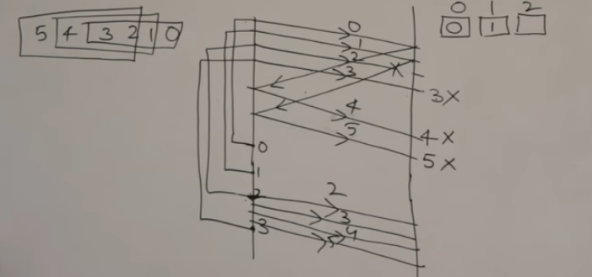
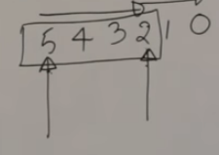

Slide 94
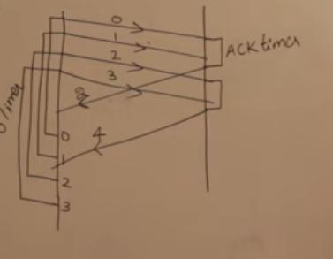

Slide 95
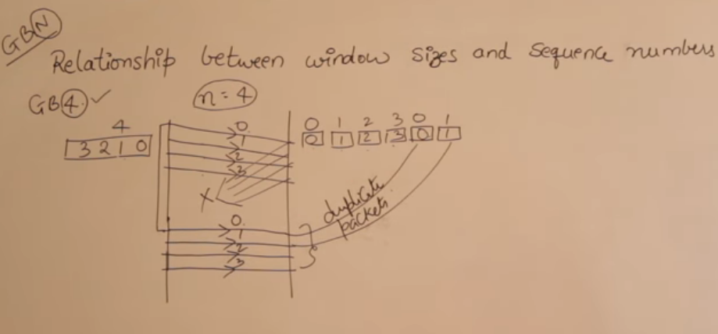

Slide 96
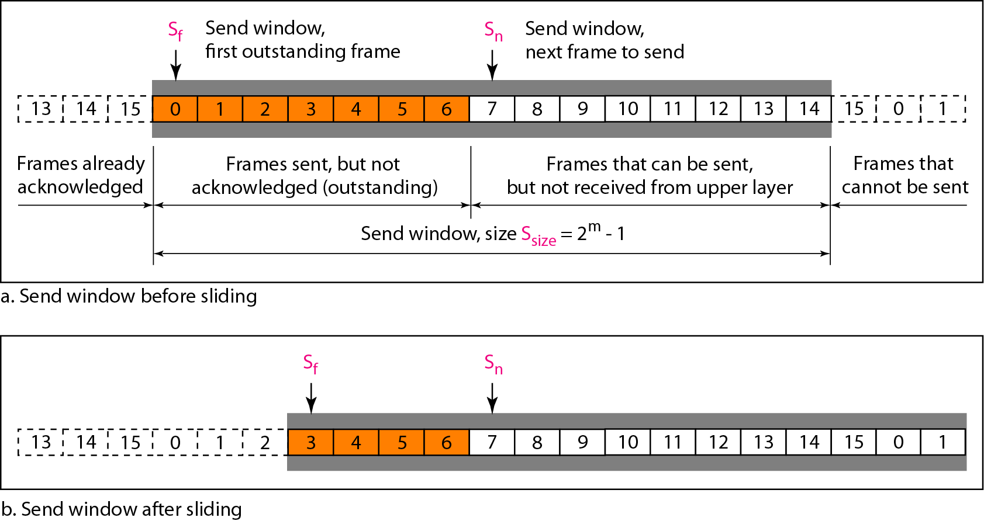
Figure Send window for Go-Back-N ARQ

Slide 97
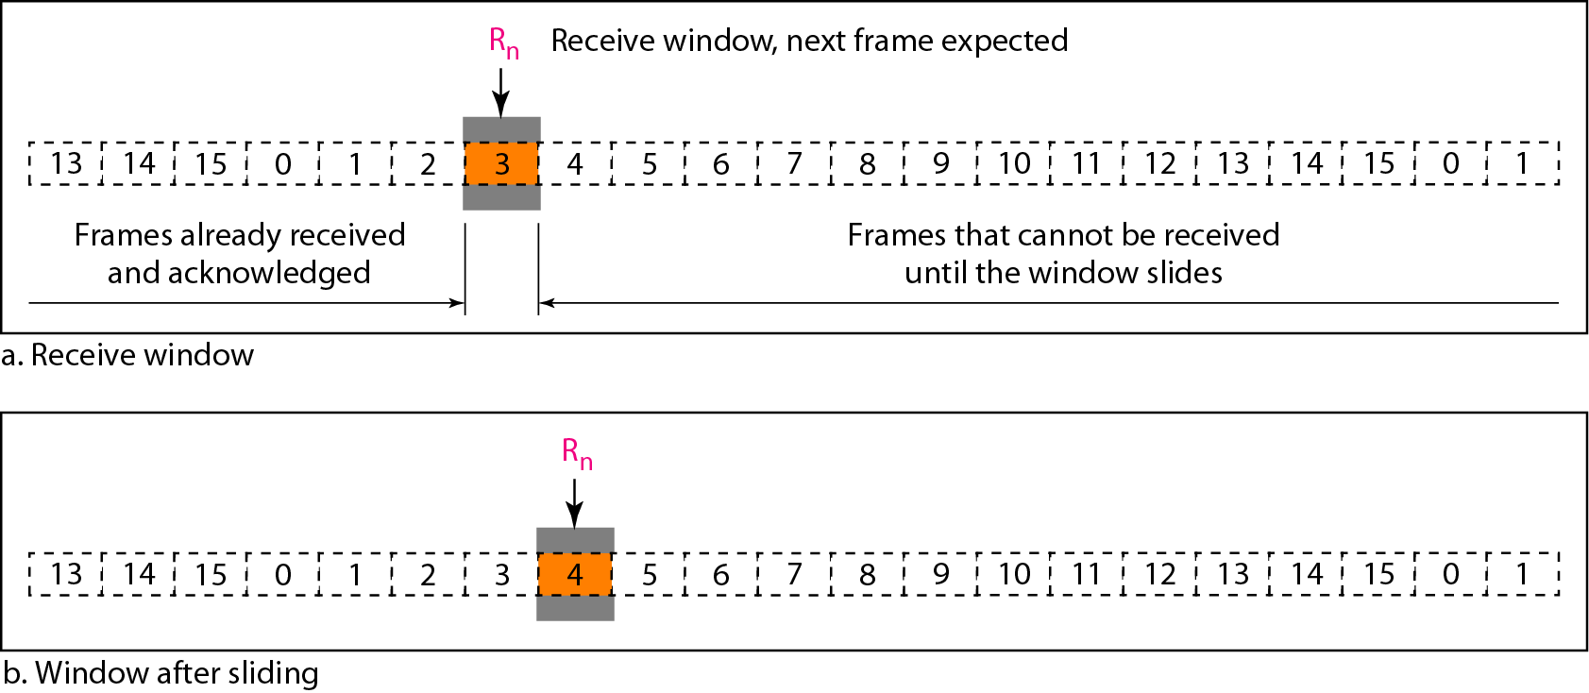
Figure Receive window for Go-Back-N ARQ

Slide 98
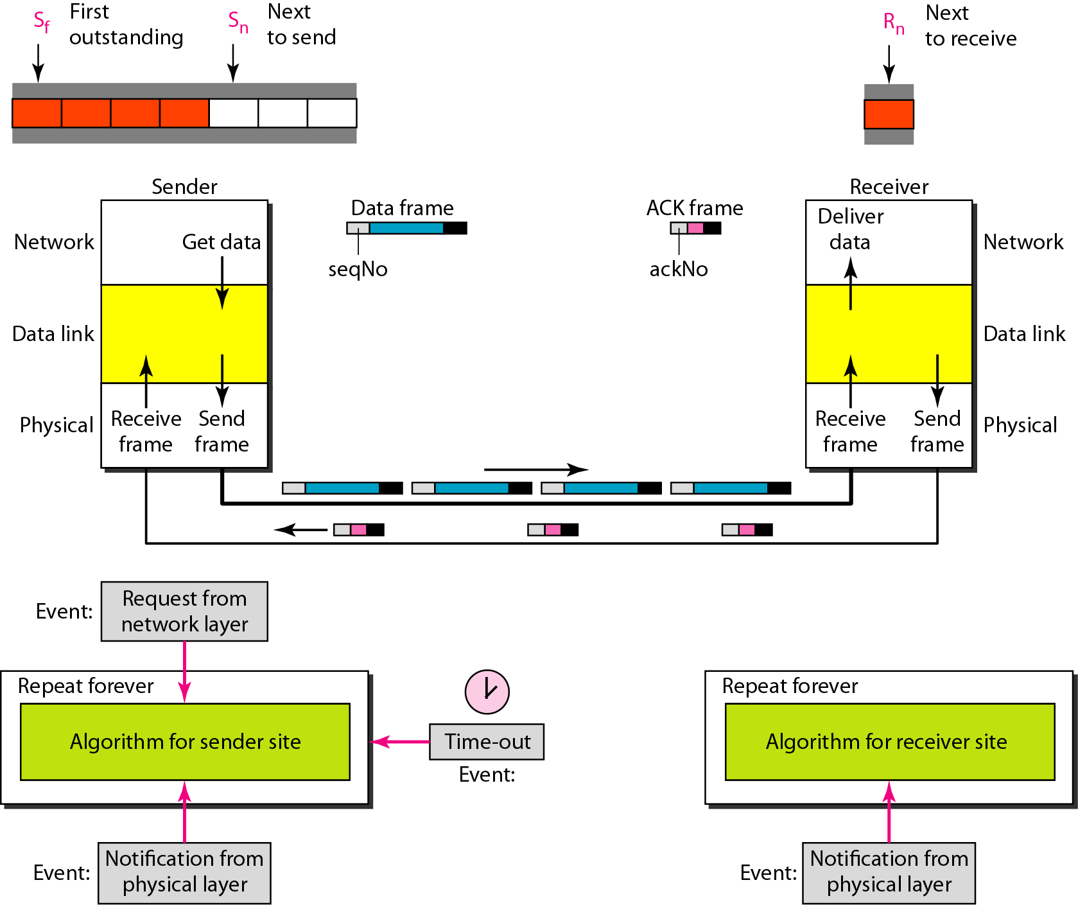
Figure Design of Go-Back-N ARQ

Slide 99
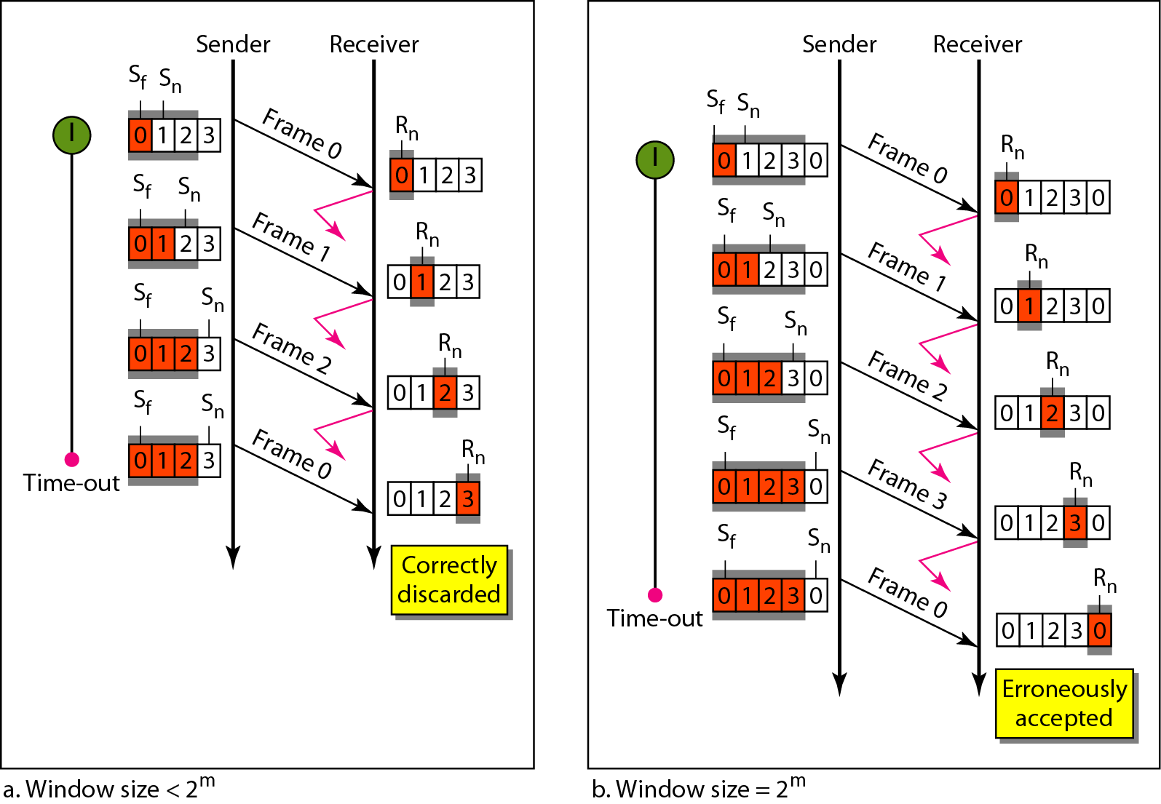
Figure Window size for Go-Back-N ARQ

Slide 100
In Go-Back-N ARQ, the size of the send window must be less than 2^{m};
the size of the receiver window is always 1.

Slide 101
Algorithm Go-Back-N sender algorithm
(continued)

Slide 102
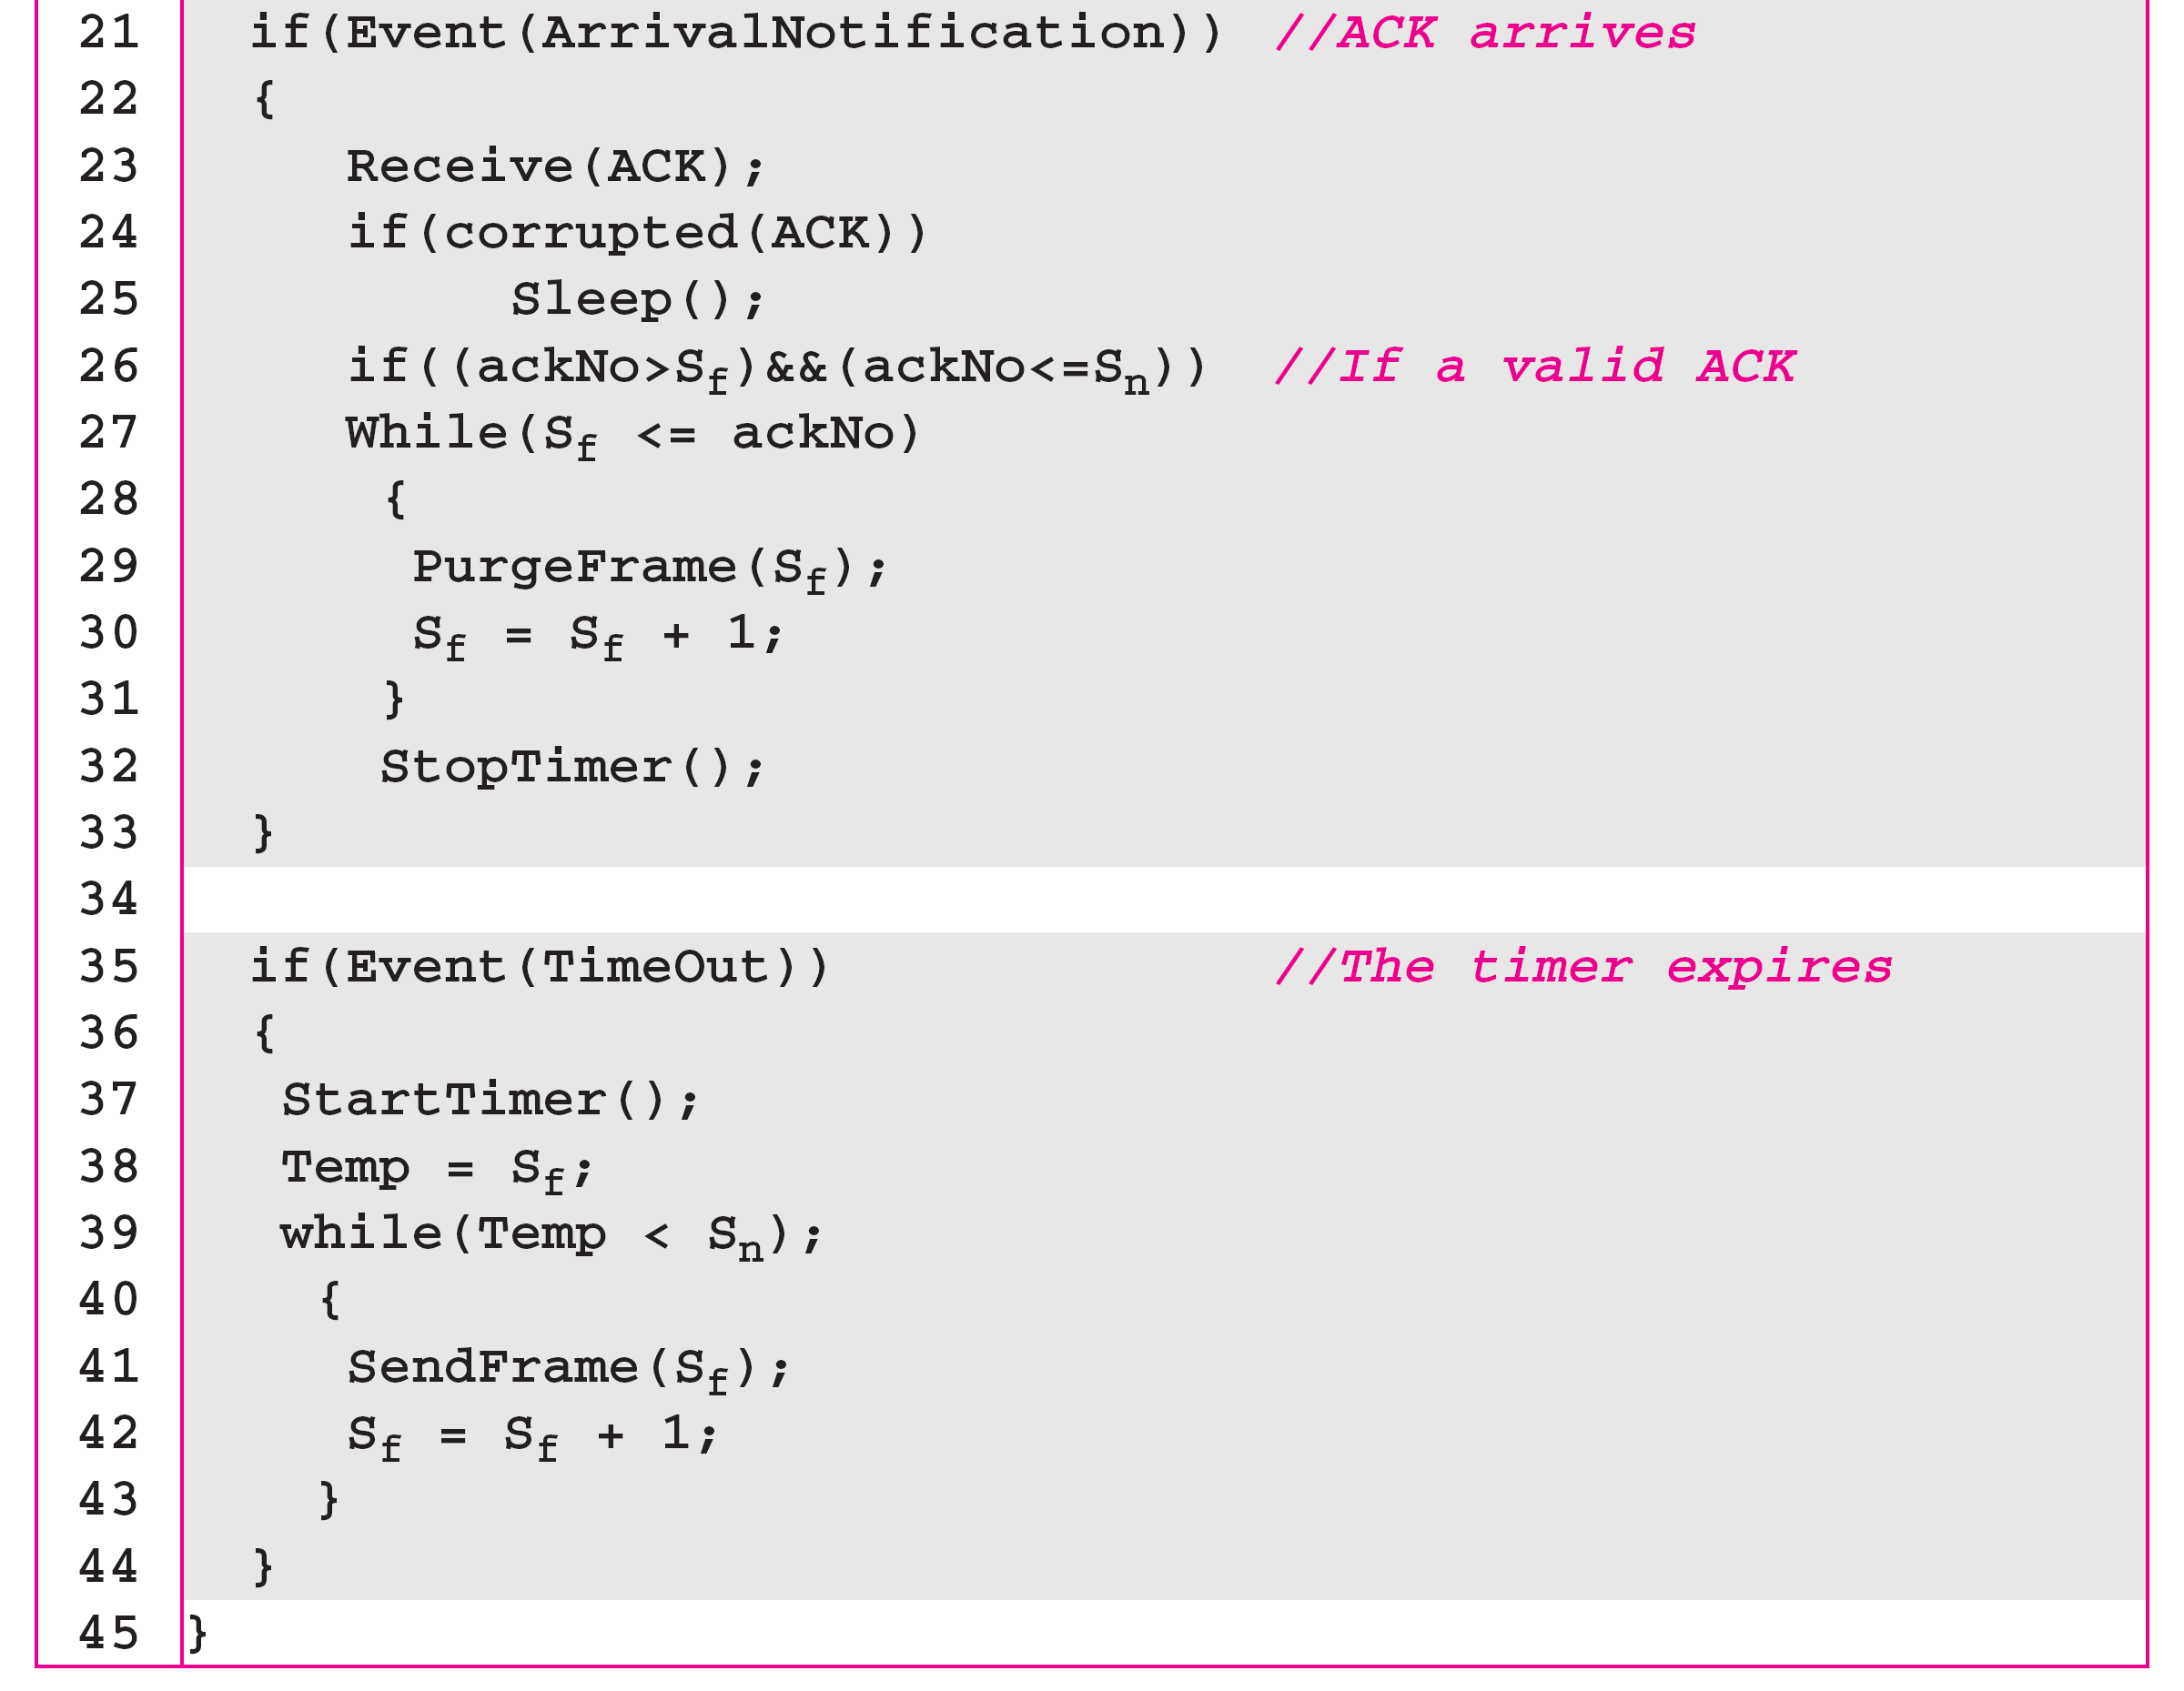
Algorithm Go-Back-N sender algorithm
(continued)

Slide 103
Algorithm 11.8 Go-Back-N receiver algorithm

Slide 104
Example
Figure shows an example of Go-Back-N. This is an example of a case where the forward channel is reliable, but the reverse is not. No data frames are lost, but some ACKs are delayed and one is lost. The example also shows how cumulative acknowledgments can help if acknowledgments are delayed or lost. After initialization, there are seven sender events. Request events are triggered by data from the network layer; arrival events are triggered by acknowledgments from the physical layer. There is no time-out event here because all outstanding frames are acknowledged before the timer expires. Note that although ACK 2 is lost, ACK 3 serves as both ACK 2 and ACK 3.

Slide 105
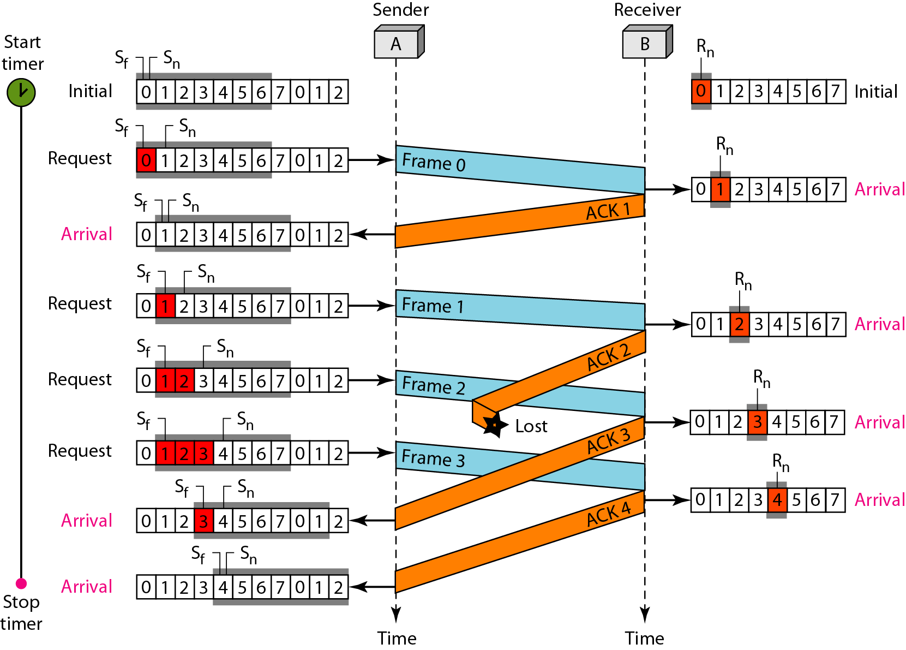
Figure Flow diagram

Slide 106
Example
Figure shows what happens when a frame is lost. Frames 0, 1, 2, and 3 are sent. However, frame 1 is lost. The receiver receives frames 2 and 3, but they are discarded because they are received out of order. The sender receives no acknowledgment about frames 1, 2, or 3. Its timer finally expires. The sender sends all outstanding frames (1, 2, and 3) because it does not know what is wrong. Note that the resending of frames 1, 2, and 3 is the response to one single event. When the sender is responding to this event, it cannot accept the triggering of other events. This means that when ACK 2 arrives, the sender is still busy with sending frame 3.

Slide 107
Example (continued)
The physical layer must wait until this event is completed and the data link layer goes back to its sleeping state. We have shown a vertical line to indicate the delay. It is the same story with ACK 3; but when ACK 3 arrives, the sender is busy responding to ACK 2. It happens again when ACK 4 arrives. Note that before the second timer expires, all outstanding frames have been sent and the timer is stopped.

Slide 108
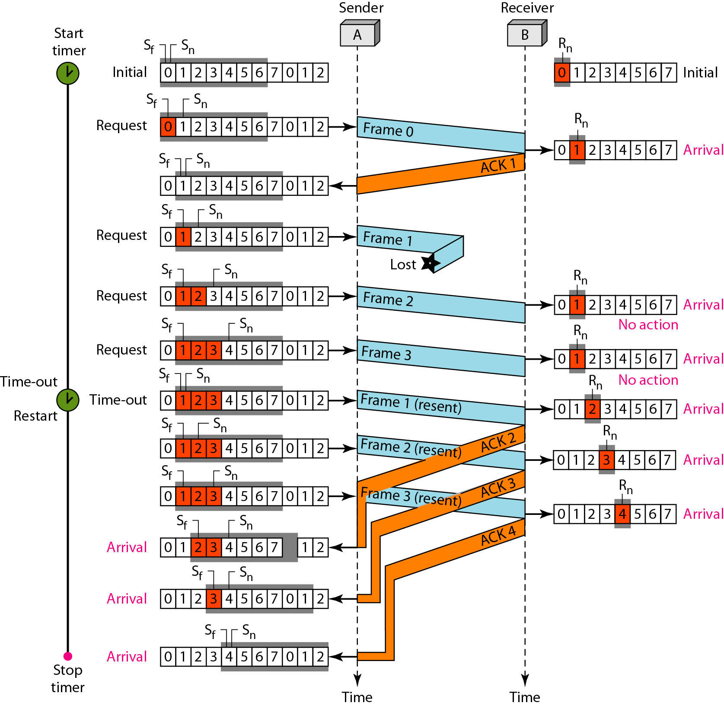
Figure Flow diagram

Slide 109
Stop-and-Wait ARQ is a special case of Go-Back-N ARQ in which the size of the send window is 1.

Slide 110
Selective Repeat Protocol
It is also sliding window protocol. Here also sender window size is >1.
Here sender window size and receiver window size is same. In go back N receiver window size is 1.
In selective repeat no order delivery of packet is required. The packet which arrive as per the window will accepted.
If packet is lost from 0 to 3 like 0 is lost remaining will accepted and after time out of 0 packet it will be retransmitted. Same with the loss of ack.
Here retransmission is less compare to go back N.
If in receive packet bit is corrupted it will send negative acknowledgment.
It require to do sorting so cpu requirement is high.

Slide 111
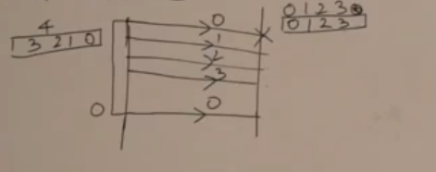

Slide 112
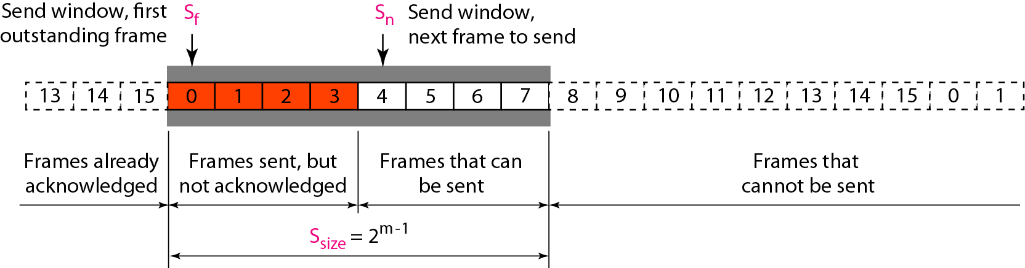
Figure Send window for Selective Repeat ARQ

Slide 113
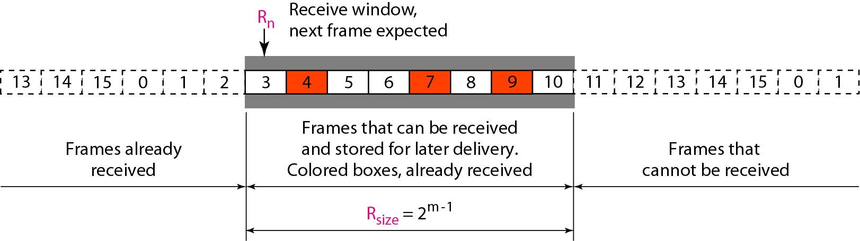
Figure Receive window for Selective Repeat ARQ

Slide 114
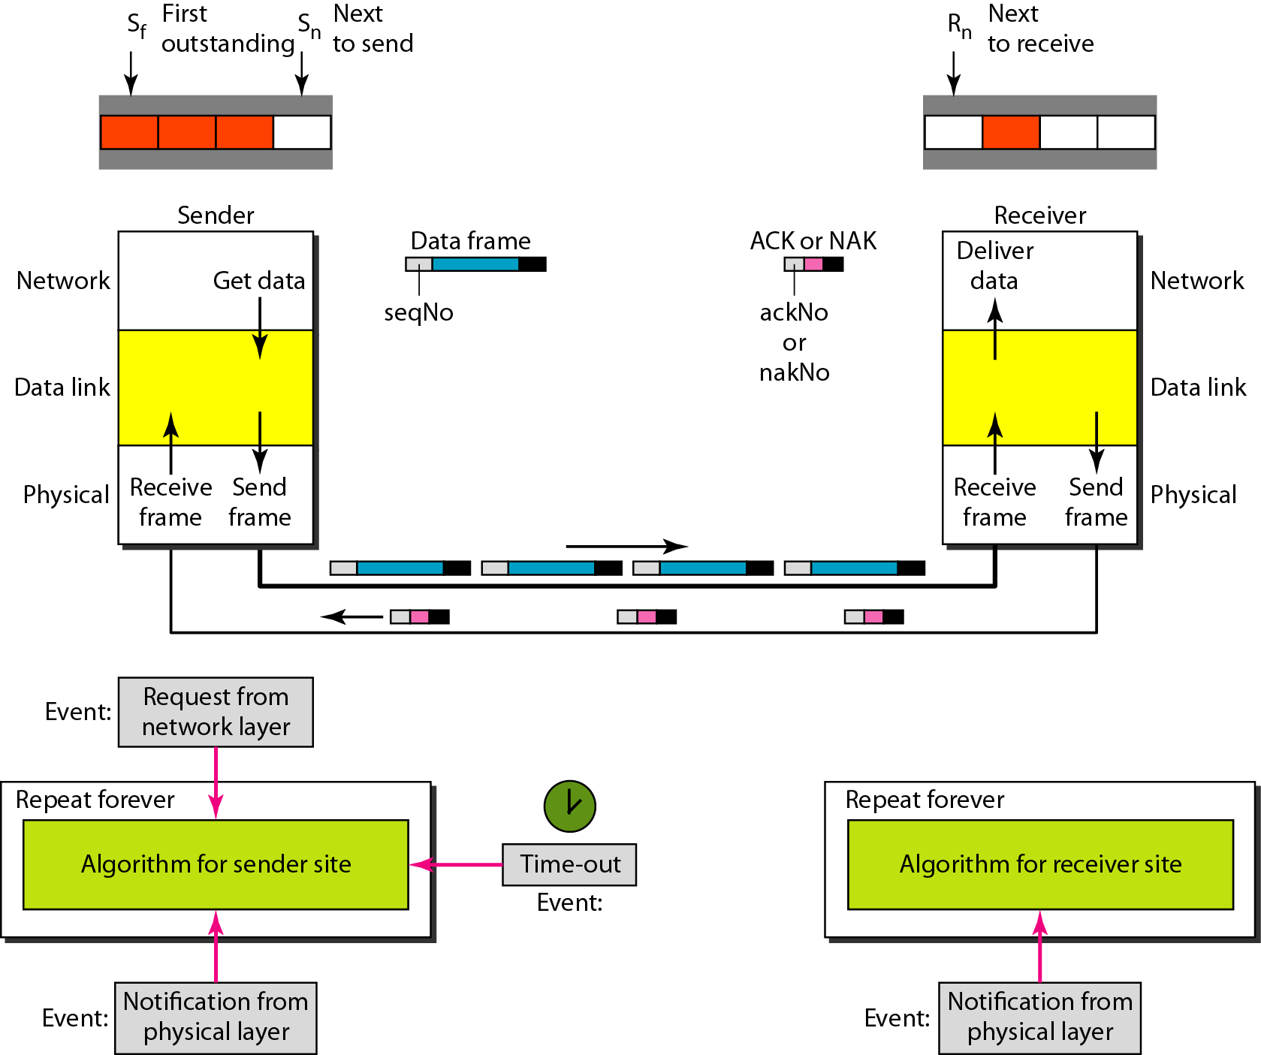
Figure Design of Selective Repeat ARQ

Slide 115
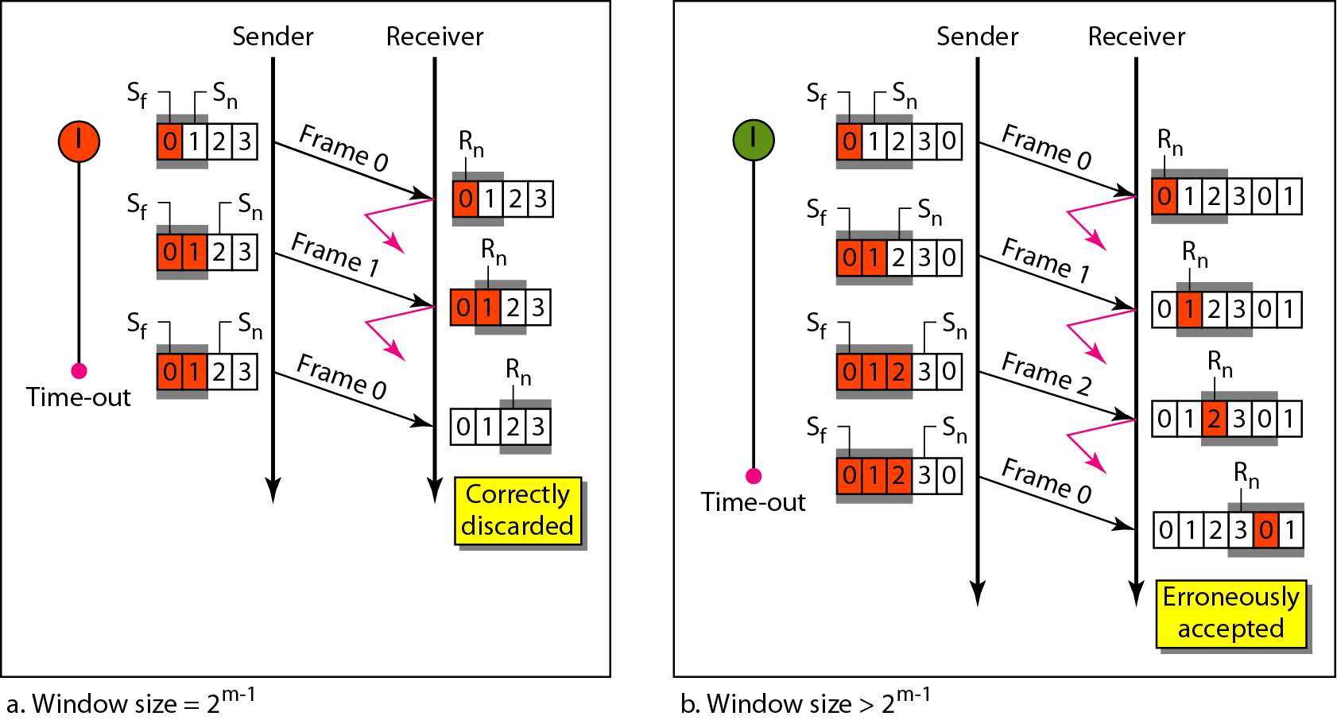
Figure Selective Repeat ARQ, window size

Slide 116
In Selective Repeat ARQ, the size of the sender and receiver window
must be at most one-half of 2^{m}.

Slide 117
Algorithm Sender-site Selective Repeat algorithm
(continued)

Slide 118
Algorithm Sender-site Selective Repeat algorithm
(continued)
(continued)

Slide 119
Algorithm Sender-site Selective Repeat algorithm
(continued)

Slide 120
Algorithm Receiver-site Selective Repeat algorithm

Slide 121
Algorithm Receiver-site Selective Repeat algorithm

Slide 122
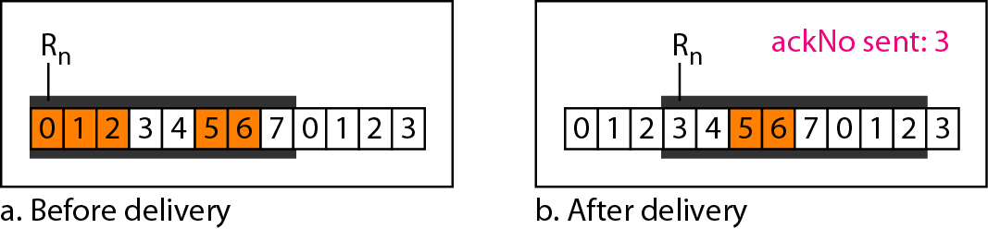
Figure Delivery of data in Selective Repeat ARQ

Slide 123
Example
This example is similar to Example in which frame 1 is lost. We show how Selective Repeat behaves in this case. Figure shows the situation. One main difference is the number of timers. Here, each frame sent or resent needs a timer, which means that the timers need to be numbered (0, 1, 2, and 3). The timer for frame 0 starts at the first request, but stops when the ACK for this frame arrives. The timer for frame 1 starts at the second request, restarts when a NAK arrives, and finally stops when the last ACK arrives. The other two timers start when the corresponding frames are sent and stop at the last arrival event.

Slide 124
Example (continued)
At the receiver site we need to distinguish between the acceptance of a frame and its delivery to the network layer. At the second arrival, frame 2 arrives and is stored and marked, but it cannot be delivered because frame 1 is missing. At the next arrival, frame 3 arrives and is marked and stored, but still none of the frames can be delivered. Only at the last arrival, when finally a copy of frame 1 arrives, can frames 1, 2, and 3 be delivered to the network layer. There are two conditions for the delivery of frames to the network layer: First, a set of consecutive frames must have arrived. Second, the set starts from the beginning of the window.

Slide 125
Example (continued)
Another important point is that a NAK is sent after the second arrival, but not after the third, although both situations look the same. The reason is that the protocol does not want to crowd the network with unnecessary NAKs and unnecessary resent frames. The second NAK would still be NAK1 to inform the sender to resend frame 1 again; this has already been done. The first NAK sent is remembered (using the nakSent variable) and is not sent again until the frame slides. A NAK is sent once for each window position and defines the first slot in the window.

Slide 126
Example (continued)
The next point is about the ACKs. Notice that only two ACKs are sent here. The first one acknowledges only the first frame; the second one acknowledges three frames. In Selective Repeat, ACKs are sent when data are delivered to the network layer. If the data belonging to n frames are delivered in one shot, only one ACK is sent for all of them.

Slide 127
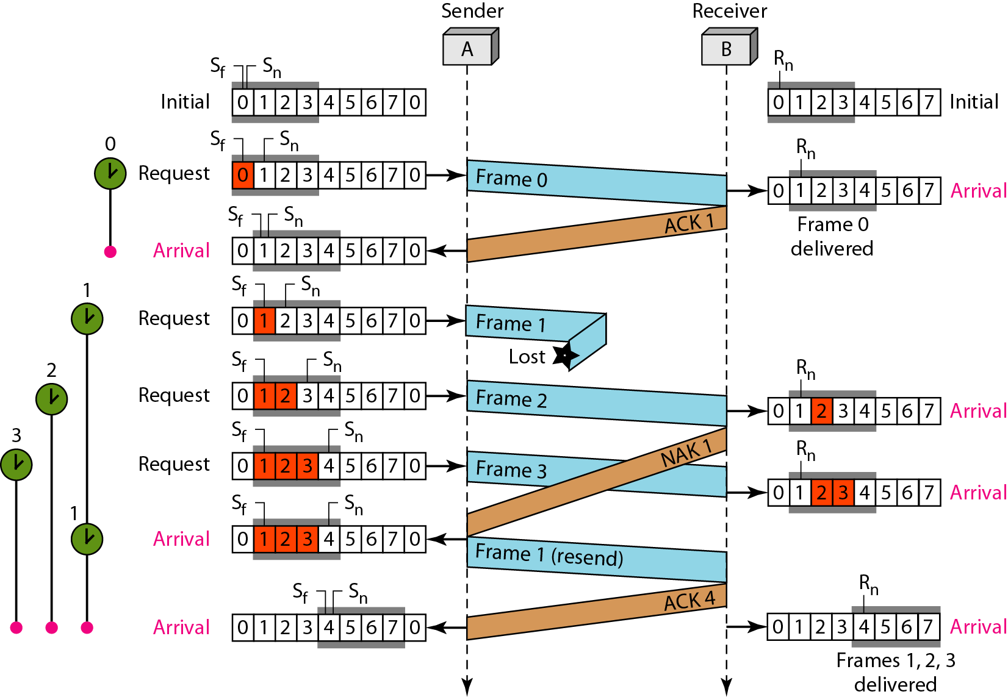
Figure Flow diagram

Slide 128
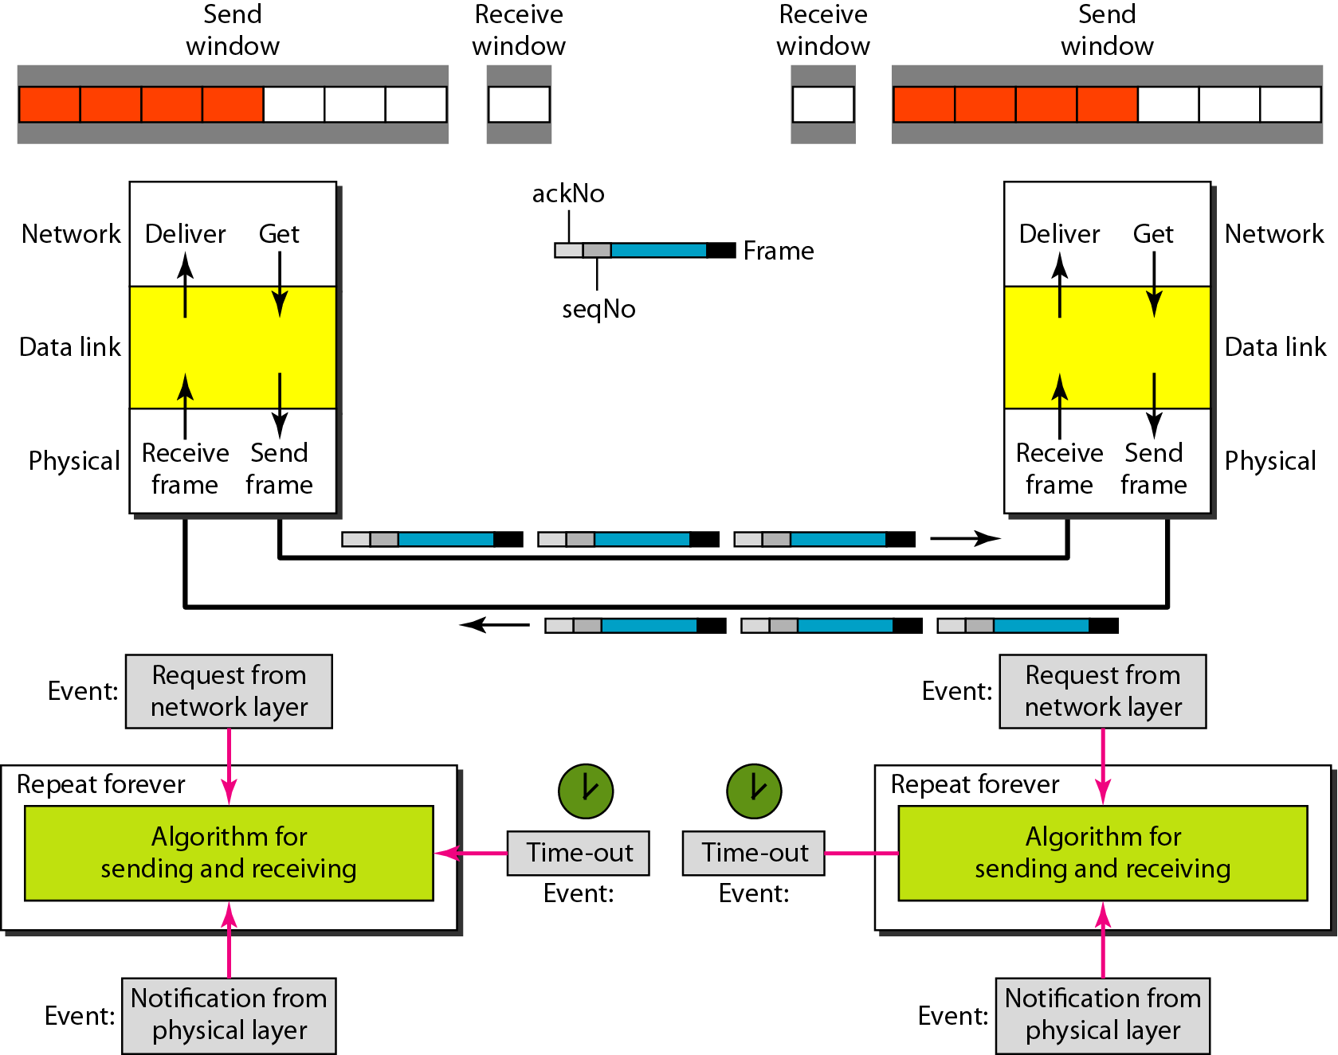
Figure Design of piggybacking in Go-Back-N ARQ

Slide 129
Piggybacking
In all previous example we have seen unidirectional communication.
If we wants to do bidirectional communication then there must be some mechanism to do flow control.
We can do by using two window at both the side sender as well as receiver side.
Here sender is sending data to receiver and receiver is sending to sender vice versa. But receiver or sender will not send an acknowledgement directly after receiving frame. They will wait for next frame and hooked acknowledgement with next outgoing frame.
Hooking of acknowledgement with next going frame is called piggybacking.

Slide 130
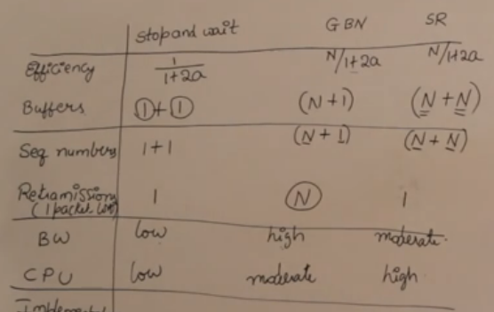
Comparison of sliding window protocol

Slide 131
Thank You

